Slide 1

Why standards that follow the guidance are good for business?
Monday 18th March 2019, Moscow (Russia)
Naoki Morooka
Member of IMDRF Standards WG
DITTA Standardization WG
Unrestricted

Slide 2
Presentation Outline
Our vision
Challenge for Consensus Standards in regulatory use.
Good For Business
Challenge in the next step

Slide 3
1. Our vision
“Approved once, accepted everywhere”
→ Future Dream
• Standards are good tools to demonstrate to comply with essential principle for the medical devices in conformity assessment process in pre-market review.
• Their process is key elements for regulatory convergence.
In Real World ; Reduce duplication!
→ MDSAP, Single Review Program in IMDRF

Slide 4
2.Challenges
Role of Standards in Conformity Assessment System
  streamline the device review process
  improve the efficiency of regulations
  establish productive dialogue among RAs, manufacturers, conformity assessment organizations (including accreditation and testing professionals), clinicians and the public.

Slide 5
2.Challenges
Contents of Standards
• Uncertain Rational for the requirements
• Uncertain Scope and residual risk
• Uncertain how to address the resulting risk as appropriate.
• Uncertain acceptance criteria and testing methods
• Competition of national and international standards

Slide 6
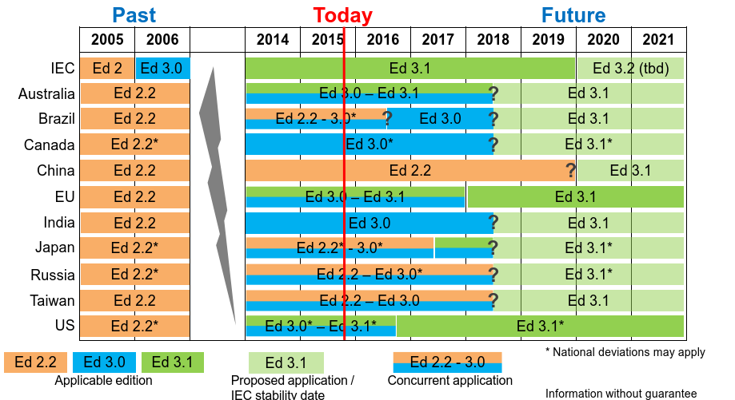

Typical Example
Implementation of IEC60601-1 Ed3
(Status in 2015)

Slide 7
3.Good for business
Expected affect after introducing this guidance document.
Conformity Assessment system based on the essential principle with the consensus standards.
Smooth introduction of international standards developed for regulatory use in each jurisdictions, and minimize the national deviations.
Acceptance of outcome based on conformity assessment for the essential principle with the consensus standards.
Avoid duplicative activities by agreeing which standards to use for regulatory framework.

Slide 8
3.Good for business
Expected affect after introducing this guidance document.
State of the art: standards represent the state of art in a technological field.
Efficiency: they should also promote economic benefits, e.g., reducing redundant reporting requirements, etc.
Verifiability: requirements include verifiable, objective measurements.
Reproducibility: testing methods in standards yield consistent results across different test facilities.
Risk Managements/Specific Requirement: When a standard identifies a hazard or a hazardous situation without giving a specific requirement.

Slide 9
3.Good for business
Review
Outcome for
conformity assessment
in premarket review
Application
Conformity Assessment in Review Organization
Essential Principle
(IMDRF N47)
Consensus
Standards
(IMDRF N51)
Competency of reviewer
(IMDRF N40)
Accepted Everywhere
“Medical Device Premarket Review
Organization Recognition Requirements and Processes”
(IMDRF Nxx : NWIP)

Slide 10
Challenge in the next step
• Establish IMDRF Liaison Program to support the developing process for regulatory use.
• Improvements the contents and the developing process for IEC60601-1 Ed4 !
But still uncertain transition rule in the revision of standards.

Slide 11

ThaNk you!
Спасибо! www.globalditta.org
Follow us on @DITTA_online

