Slide 1

Future of ISO 13485 and update on ISO 14971
Monday 18th March 2019, Moscow (Russia)
Peter Linders
SWG member, Chair ISO/TC 210, Chair DITTA Standardization WG
Unrestricted

Slide 2
Presentation Outline
Introduction
What again is ISO’s HLS (high-level structure)?
Future of ISO 13485 (Medical devices -- Quality management systems -- Requirements for regulatory purposes)
Update on revision of ISO 14971 (Medical devices -- Application of risk management to medical devices)
Take Aways

Slide 3
Introduction
ISO 13485:
Ed. 3 published on 1 March 2016
Is a management system standard (MSS), type A
Is –in principle- subject to ISO HLS
ISO 14971:
Ed. 2 published in 2007
Revision almost done – publication expected in 2019
Comes with ISO/TR 24971 and new Guide 63
Is not an MSS …

Slide 4
ISO HLS
What is ISO’s High-Level Structure ?
  HLS represents common part of ISO’s Management System Standards (MSS)
  HLS aims to ‘standardize’ MSSs
  HLS aims to support development of MSSs
  HLS aims to facilitate implementation of multiple MSSs in an organization
  HLS is not just a structure, also normative text
  HLS was designed for enterprise management systems
  HLS is mandatory for all ISO MSSs

Slide 5
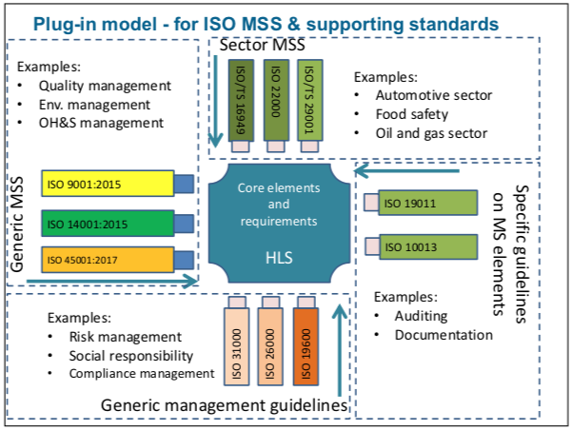
ISO HLS
Conceptual model of ISO HLS
Notes:
The mentioning of the automotive sector is interesting …
On October 3rd, 2016 IATF 16949:2016 was published by the IATF and supersedes and replaces the current ISO/TS 16949, defining the requirements of a quality management system for organizations in the automotive industry.
(source: https://www.quora.com/What-are-the-ISO-standards-for-the-automotive-industry)

Slide 6
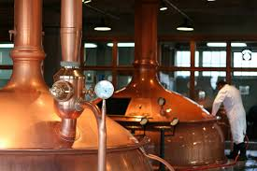
ISO HLS
ISO/IEC Directives Part 1 - Annex SL, Appendix 2:
High level structure, identical core text, common terms and core definitions
NOTE In the Identical text proposals, XXX = an MSS discipline specific qualifier (e.g. energy, road traffic safety, IT security, food safety, societal security, environment, quality) that needs to be inserted
Over 10 pages of normative core text …
So HLS is not just a structure
OTAGMSS* and a BBMSS**
* on-line tool for automatic generation of management system standards (not yet available)
** BBMSS: beer brewery management system standard

Slide 7
Future of ISO 13485
So, in principle, ISO 13485 must be made HLS compliant with the next revision
(And also normatively reference ISO 9001)

Slide 8
Future of ISO 13485
However:
Normative language in HLS does not fit well regulatory purposes
HLS is in revision, target effective date: 2022
Likelihood of substantive change is minimal
At ISO 13485 workshop in Seoul (Nov 2018), many stakeholders requested (at least) 5 year stability
Systematic review of ISO 13485 starts next month

Slide 9
Future of ISO 13485
Ambition of the ISO/TC 210 leadership:
maintain the usefulness of ISO 13485 for the purposes it had for the last 25+ years
Note: “Requirements for regulatory purposes” is in the title

Slide 10
Revision of ISO 14971
Revision of ISO 14971:2007 comes with:
Revision of ISO/TR 24971:2013 (Medical devices – Guidance on the application of ISO 14971)
Update of ISO/IEC Guide 63:2012 (Guide to the development and inclusion of aspects of safety in international standards for medical devices
(text in collaboration with Dr. Jos van Vroonhoven, JWG1 convener)

Slide 11
Revision of ISO 14971
Major changes in ISO 14971:2019
  New Clause 2 on normative references, per ISO/IEC Directives
  Steps in risk analysis are re-arranged in more logical order
  New defined terms “benefit”, “reasonably foreseeable misuse”
  Emphasis on benefits in evaluation of overall residual risk
  Instruction to mfrs. to disclose significant residual risks
  More detailed requirements for production and post-production activities
  FDIS ballot April/May 2019; publication of standard in 2019

Slide 12
Revision of ISO 14971
Major changes in ISO/TR 24971:2019
  Complete revision of ISO/TR 24971:2013
  Clause numbering is equal to that in ISO 14971
  Additional annexes to clarify specific topics
  Some annexes of ISO 14971:2007 moved to TR, merged with existing guidance in ISO/TR 24971:2013,
  Updated and supplemented with more guidance
  DTR ballot late spring 2019; publication expected in 2019

Slide 13
Revision of ISO 14971
Notes on ISO/IEC Guide 63:2019
  Guide is intended for writers of standards for medical devices, when developing/revising standards
  Current Edition (2012) was based on ISO 14971:2007
  Edition 3 is basis for ISO 14971:2019 and for other standards
  Definitions in Guide 63 are aligned with GHTF/IMDRF and with ISO 14971:2019 and ISO 13485:2016
  Dguide approved (2x100%!); publication expected soon

Slide 14
Take Aways
Future of ISO 13485 not yet fully clear
ISO/TC 210 will strive for continued usefulness
Close alignment with IMDRF is important
Outcome of systematic review expected mid 2019
Revision of ISO 14971 and associated documents (ISO/TR 24971 and ISO/IEC Guide 63) almost done
No fundamental change in process approach

Slide 15

ThaNk you! www.globalditta.org
Follow us on @DITTA_online

