Slide 1
Guidance Structure and Key Proposal
- overview -
Optimizing Standards for Regulatory Use
IMDRF/Standards WG/N51 FINAL: 2018
Madoka Murakami
IMDRF Standard WG
PMDA, JApan

Slide 2
GHTF/SG1/N44: 2008 “Role of Standards in Assessment of Medical Devices”
IMDRF/Standards/N51: 2014 “Final Report: List of International Standards Recognized by IMDRF Members as of March 2014”
Report: Improving the Quality of International Medical Device
Standards for Regulatory Use
IMDRF/Standards/N51: 2018 “Optimizing Standards for Regulatory Use”
List of International Standards Recognized by IMDRF Members as of 2018/2019
Implementation
Survey on standard recognition policy
NWIP
Future
SOP for liaison structure with ISO/IEC
Best practices and policies for the use and recognition of standards
  Empowers IMDRF goal of harmonized regulatory approaches

Slide 3
Standard
X
E1
E4
E5
E2
E1
E3
E6
E6
E: Experience, technology, knowledge

Slide 4
IMDRF Essential Principles
The IMDRF EPs provide broad, high-level criteria for design, production, and postproduction (including post-market surveillance) throughout the life-cycle of all medical devices. They provide a framework for regulatory expectations and represent a consensus on fundamental design and manufacturing requirements that, when met, indicate that a medical device is safe and performs as intended and offers significant benefit.

Slide 5
“IMDRF Essential Principles”
Chapter 4: General Principles
Chapter 5: Essential Principles Applicable to all Medical Devices and IVD Medical Devices
Chapter 6: Essential Principles Applicable to Medical Devices other than IVD Medical Devices
Chapter 7:Essential Principles Applicable to IVD Medical Devices
Appendix A: Use of Standards in Meeting Essential Principles
Appendix B: Guidance on Essential Principles

Slide 6
Test2
Test1
Test4
Test5
Test3
Test2
Test1
Essential Principles
Test4
(Standards)
Test3
Test2
(Standards)
Test1
Test3
(Standards)

Slide 7
Test2
Test1
Test4
Test5
Test3
In general, any tests method should be acceptable if the result of tests shows the conformance with the EP
But……
Test2
Test1
Essential Principles
Test4
(Standards)
Test3
Test2
(Standards)
Test1
Test3
(Standards)

Slide 8
The use of consensus standards
Enhance transparency
Reduce duplication
Reduce oversight
Enhancing quality of application/review
Time saving
Cost saving

Slide 9
Technologies and Standards
Innovative
technologies
Challenges
Existing technologies/
knowledge
Standards
MD1
MD2
MD3

Slide 11

  How to improve standards and standards developing processes for use in device review
Two elements
  Improving standards’ content to enhance utility for regulatory purposes
  Encouraging regulatory authority participation in standards development
Public consultation
Publication October 2018
Notes:
Public consultation yielded more than 200 comments from standards experts from around the world

Slide 12
Audience
  Regulators
  SDOs
  Medical device community
Scope
  Resource for standards writers and regulators
  All medical devices, including IVD

Slide 13
Main Chapters
General
Recommendation for Standards Development
Enhancing Stakeholder Participation in Standards Development
IMDRF and Standards Developing

Slide 14
General
Standards should map to IMDRF Essential Principles of Safety and Performance of Medical Devices and IVD Medical Devices (2018)
Performance versus design stipulations
Characteristics for optimized international standards
Notes:
These three principles guided our work; next we will review each of these individually.

Slide 15
1. Map to IMDRF Essential Principles
General
Standards should reflect:
  A close relationship between the standard’s scope and one or more of the IMDRF EPs
  The clarity and completeness of the requirements contained in the standard as it relates to a specific EP
  Test methods for determining compliance with each of the requirements in the standard, and clear acceptance criteria for determining that each technical requirement is met

Slide 16
2. Performance versus Design Stipulations
General
Express a standard’s requirements with references to performance, rather than to specific device features
Fosters innovation and healthy marketplace dynamics
An example from the ISO/IEC Directives Part 2 illustrates this principle:
    Different approaches are possible in the specification of requirements concerning a table:
    Design requirements: The table shall have four wooden legs.
    Performance requirements: The table shall be constructed such that [the table top remains level and at its original height] when subjected to … [stability and strength criteria].
Notes:
The second general principle: rely upon performance expectations rather than specifying design attributes.

Slide 17

3. Characteristics
General
Consensus: standards should be written under conditions that promote accessibility, transparency, broad representation and consideration of interests through consultations.
Fairness: the needs of all stakeholders, including regulators, are considered in standards development.
Compatibility: standards are compatible with the internationally accepted principles of safety and performance of medical devices.
State of the art: standards represent the state of art in a technological field.
Notes:
No need to read or review each individual feature of consensus standards if time is an issue.

Slide 18
General
3. Characteristics (cont’d)
Efficiency: they should also promote economic benefits, e.g., reducing redundant reporting requirements, streamlining regulatory activities and harmonizing expectations across different countries and regions.
Completeness: within its scope, a standard address all predictable elements related to Essential Principles of device safety and/or performance.
Verifiability: requirements include verifiable objective measurements.
Repeatability: testing methods in standards will yield consistent results across different certified test houses.
Consistency: terms and symbols across standards are as consistent as possible.
Clarity: standards are clear, unambiguous, and easily understood.
Accessibility: standards and associated documents should be reasonably available to relevant stakeholders.
Notes:
Third general principle: rely upon consensus standards, as they feature these attributes.

Slide 19
Recommendation for Standards Development
Optimizing standards content
Best practices for standard development procedures
Use of standards in meeting IMDRF Essential Principles
Notes:
The first element of the guidance outlines how standards’ content can be enhanced. These – and those listed on the next slide - are a few of the recommendations in the guidance.

Slide 20
1. Optimizing Standards Content
Recommendation for Standards Development
Standards should be crafted so that conformity to them can reduce regulatory burden, demonstrate conformance to IMDRF’s EPs, and feature:
  A strong rationale that:
    Explains the general requirements and identifying test methods and/or other means of demonstrating compliance
    Demonstrates how conformance to the standard achieves its goal of satisfying the associated EPs
  Summary of the type of stakeholder groups involved in the drafting and editing of the standard
  Identification of risk and direction on how to address
  A clear scope
  Terms and definitions established and accepted in other standards
  Means to assess clinical performance if applicable as part of the normative requirements
Notes:
The first element of the guidance outlines how standards’ content can be enhanced. These – and those listed on the next slide - are a few of the recommendations in the guidance.

Slide 21
1. Optimizing Standards Content
Recommendation for Standards Development
Standards should feature (cont’d):
  Clear and quantitative acceptance criteria that can adequately support IMDRF EPs
  Explanation of how conformance can be met if no acceptance criteria are included
  If acceptance criteria not mandatory, justification for why, and how to demonstrate conformance to the standard
  Well accepted and verified test methods (including for new or unfamiliar methods)
  Transparent and clear (e.g., ‘track changes’) revisions
  An annex or table that cross references the standard’s clauses to the Essential Principles
Notes:
Continued from previous slide…

Slide 22
Recommendation for Standards Development
2. Best practices
Consider regulatory requirements at every step
Write a strong Business Plan
  Robust needs analysis: market, safety, regulatory
  Expectations for regulatory utility
  Emphasize conformity assessment
Encourage and solicit a wide variety of expertise
Get involved – early!
Notes:
How can regulators participate effectively?

Slide 23
Enhancing Stakeholder Participation in Standards Development
International, regional and national level participation: joining the conversation
Recommendations for participation: submitting effective comments

Slide 24
1. Joining the conversation
Enhancing Stakeholder Participation in Standards Development
Regulators should build a strong standards program that encourages contributions to standards development
Engagement with SDOs is essential
  Through National Bodies and Mirror Committees
  On SDO Technical Committees
Contribute regulatory perspective
Consider leadership roles
Notes:
To increase utilization of standards for regulatory applications, RAs should participate in standards development at both the national and international levels. At the international level, RA engagement is welcomed in the various committees within IEC and ISO and regulators are strongly encouraged to serve as experts through their official country delegations.
Equally important is participation in the mirror committees. As noted above, the national bodies develop consensus on their countries’ positions and votes; their nominating function to ISO and IEC delegations makes national level engagement even more important for RAs. This accessibility at the national level supports consensus principles and is an important feature that facilitates participation in standards development without requiring the membership and resources necessary for ISO and IEC membership.

Slide 25
2. Submitting effective comments
Enhancing Stakeholder Participation in Standards Development
Get involved early (at NWIP stage) and remain engaged throughout the entire process
Become familiar with the draft
Listen to others, consult regulatory colleagues
Consider impact on regulatory processes, especially conformity assessment, testing methods and audit requirements
Articulate your position clearly and concisely
Use SDO’s approach and templates
Offer alternative language

Slide 26
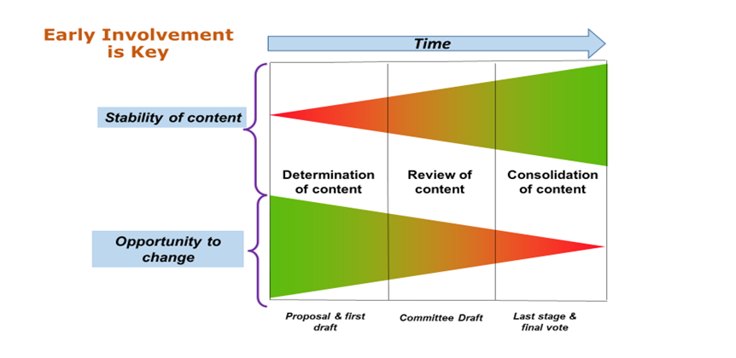

Slide 27
IMDRF Essential Principles
Optimized International Standards
International
IMDRF
SDOs
Mirror Committees
Regional/National
Other
stakeholders
RAs
Industries

Slide 28


Any Questions?
???

Slide 29
Thank you!!

