Slide 1
How IEC can contribute to IMDRF to support regulatory convergence
Katharine Fraga Head, Governance & Strategy, IEC
IMDRF-DITTA
2019-03-18
Moscow

Slide 2
IMDRF vision = IEC vision
Bring affordable and safe medical treatments to all patients who need them:
Establish mechanism to recognize International Standards + method of demonstrating conformity
Accelerate regulatory harmonization and convergence
Notes:
IMDRF is looking to accelerate international medical device regulatory harmonization and convergence and has identified that use of international standards are an effective way to support this objective
At IEC, we share the IMDRF vision and so we are eager to collaborate with IMDRF in a global effort to foster regulatory harmonization.

Slide 3
IEC: a key harmonization tool
International Standards
Conformity Assessment Systems
Notes:
IEC International Standards together with testing and verification are a key tool to achieve regulatory convergence and assure the safety, quality and performance of medical devices.

Slide 4
Input from many stakeholders
86 National Committees
Consensus: main principle
State of the art: top experts
Fairness: public and private sector involvement
Verification: IECEE is a unique approach
Efficiency: applicable worldwide
Notes:
But you might wonder what makes an IEC International Standard different from a national or regional standard?
One fundamental difference is that IEC International Standards are consensus-driven.
In short:
In the IEC, many experts from many different countries participate in the standardization process. They discuss solutions to challenges and only when at least 75% of all experts agree and every major issue has been laid to rest, a Standard can be sent to approval.
Each Member country that participates in the standards work, has only one vote. This avoids that a single region or country is able to push its needs to the forefront to the detriment of others.
That’s how consensus is achieved.
The outcome is a Standard that is near universally relevant, can be used by all and helps level the playing field.
Verification: Whenever possible, requirements in IEC International Standards are expressed in terms of performance rather than design or descriptive characteristics. They form the basis for testing and certification, which confirms that Standards have actually been applied in the real world.

Slide 5
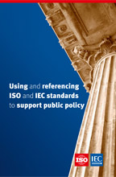
Using IEC & ISO work
Advantages
Methods
Considerations
Access
Case studies

Slide 6
IEC strategy
“Particular attention should be given to regulators and policy makers”
Notes:
IEC long-term strategy – community identified regulators and policy makers for particular attention

Slide 7
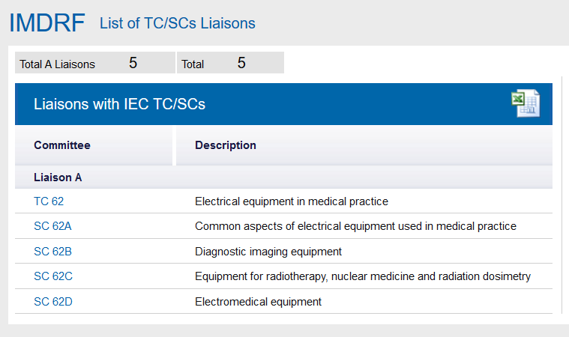
The partnership
Notes:
Last year we signed an MoU with IMDRF: working together for mutual benefit
And we established five liaisons with IMDRF: you can participate in the TC/SC meetings, receive draft documents for commenting purposes and send experts to WGs

Slide 8
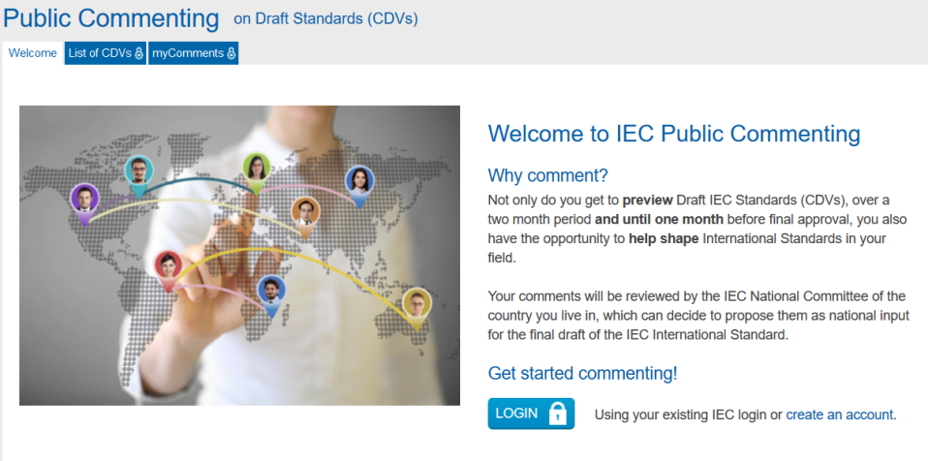
How to have influence
Individually:
NC mirror committee
Public commenting
As IMDRF
Attend TC/SC meetings
Comment on working documents
Send experts to WGs

Slide 9
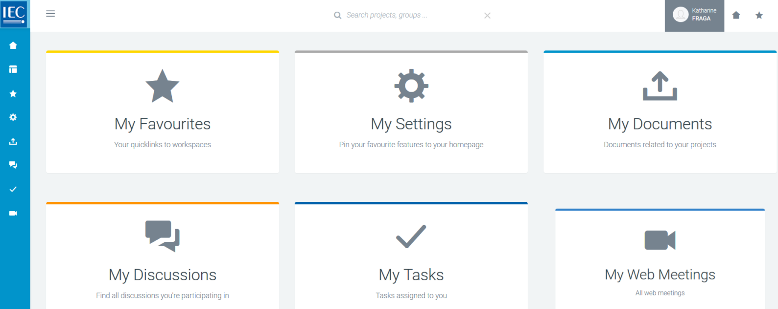
Liaison benefits
Collaboration Platform: access documents, commenting
Meetings
Nominate experts
New work item proposals
Notes:
Not voting but equal influence to other stakeholders:
Any comments from liaison organizations should be given the same treatment as comments from member bodies.
Access to documents – drafts and final standards (for the purpose of standard development work)
Commenting
Meetings – plenary

Slide 10
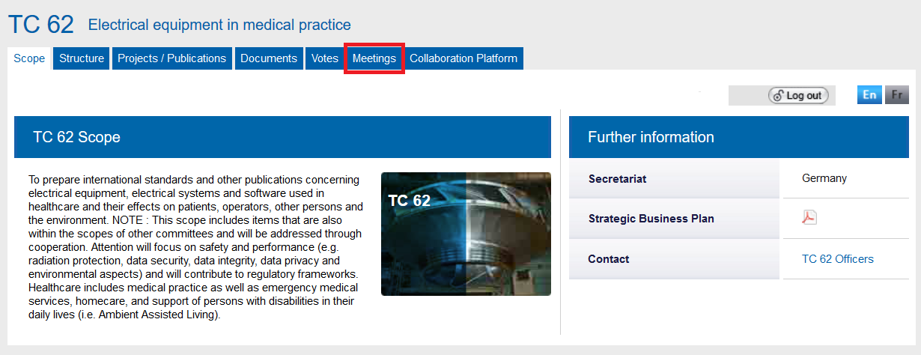
Upcoming meetings
IEC 60601 series future architecture: AhG meeting, 7-9 May, Germany
TC 62 plenary meeting, 20-25 October, China

Slide 11
How IEC can help
Webinar series on IEC
IMDRF - IEC event
Connect IMDRF member to NC training

Slide 12
Katharine Fraga Head, Governance & Strategy, IEC
IMDRF-DITTA
2019-03-18
Moscow

