Slide 1

How new work items come to be
“good standards development practice”
Monday 18th March 2019, Moscow (Russia)
Peter Linders
SWG member, Chair ISO/TC 210, Chair DITTA Standardization WG
Unrestricted

Slide 2


Presentation Outline
Introduction
Mechanics of standards development
Structured approach
Tools
What’s critical?
Take aways

Slide 3
Introduction
Development of (IEC, ISO) standards is simple …
… if you know what to do
Oh well, there are a few boundary conditions:
  Adhere to WTO principles
  Adhere to prescribed format
  Follow prescribed processes
  Subject to national members approval
See ISO/IEC Directives 1&2
Notes:
Many, many standards are being published every month, so it cannot be difficult …

Slide 4
Introduction
WTO principles (Directives pt 1, Annex SM.1):
Effectively respond to regulatory and market needs (in the global marketplace)
Respond to scientific and technical developments in various countries
Not distort the market
Have no adverse effects on fair competition
Not stifle innovation and technological development
Not give preference to characteristics or requirements of specific countries or regions when different needs or interests exist in other countries or regions
Be performance based as opposed to design prescriptive
Notes:
Many, many standards are being published every month, so it cannot be difficult …

Slide 5
Introduction
More principles (Directives pt 1, Annex SO.2):
a) ISO and IEC are committed to creating market-driven International Standards, based on objective information and knowledge on which there is global consensus, and not on subjective judgments, in order to provide credible technical tools that can support the implementation of regulation and public policy initiatives.
b) ISO and IEC are committed to developing International Standards that are market relevant, meeting the needs and concerns of all relevant stakeholders including public authorities where appropriate, without seeking to establish, drive or motivate public policy, regulations, or social and political agendas.
Notes:
Many, many standards are being published every month, so it cannot be difficult …

Slide 6
Introduction
Still more principles (Directives pt 1, Annex SO.3):
transparency
openness
impartiality and consensus
relevance and effectiveness
coherence
development dimension
For details of these principles, see Annex 4 to the Second Triennial Review of the TBT Agreement.
Notes:
Many, many standards are being published every month, so it cannot be difficult …

Slide 7
Mechanics
ACTION:
Vote + comments
Comments
Vote + comments
Vote
Publication
NP
New work item Proposal
Committee Draft
CD for Vote (IEC) /Draft Intl. Std. (ISO)
Final Draft Intl. Standard
Publication
CD
CD
CDV/DIS
CDV/DIS
FDIS
Intl Std
Similar process for TR, TS, and PAS
Notes:
Depending on the quality of of comments and of the work done, there may be a need for a 2nd CD and/or a 2nd CDV.

Slide 8
Structured approach
TC/SC
P-members
O-members
NCs
IS Process
1. Preliminary Stage
(PWI)
NC interest ?
2. Proposal Stage
(NP, RVN)
≥2/3 P-mem vote &
≥4(or 5) NCs experts
WG / PT
Working Group stage
(draft documents)
3. Preparatory Stage
(WD)
TC stage
(comments)
4. Committee Stage
(CD, CC)
5. Enquiry Stage
(CDV, RVC)
2 voting stages
≥2/3 P-mem. vote
&
<25% neg. vote
(both stages)
6. Approval Stage
(FDIS, RVD)
7. Publication Stage
(IS)
Detailed workflows on IEC website

Slide 9
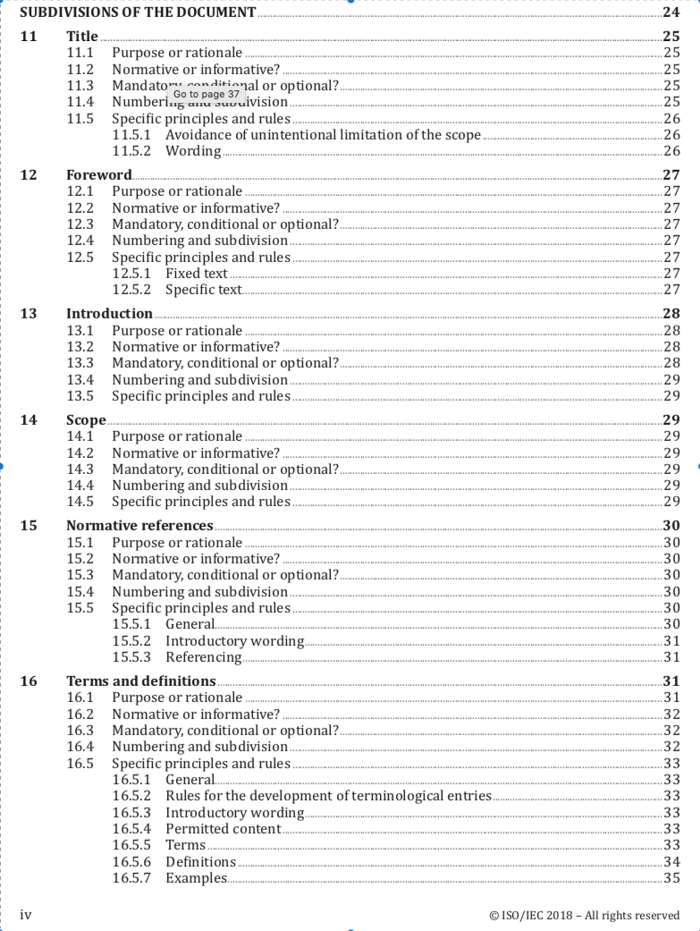
Tools
Obviously, IEC and ISO demand a “standard approach” …
Part 2 of ISO/IEC Directives
describes just that …
Lots of support tools are there
to help drafting of standards
Among them: ISO/IEC Guides,
e.g. Guide 51, Guide 63
NB – Part 1 of Directives is about structuring the work

Slide 10
What’s critical?
Three elements are decisive for a good standard development and timely delivery:
New work item Proposal (NP)
Stakeholder representation
Convener

Slide 11
What’s critical?
Three critical elements:
1) New work item Proposal (NP)
Reflects clear vision of intended deliverable
Has solid justification for the effort to be made
Is realistic about time needed
Might refer to selected “Essential Principles”

Slide 12

What’s critical?
Three critical elements:
2) Stakeholder representation
Broad group of experts (expertise, nationality, …)
Collaborative attitude
Preferably available for the entire project
Ideally: mix of expertise tailored to project
Often depends on experts “made available”

Slide 13
What’s critical?
Three critical elements:
3) Convener
Consensus builder
Must have ample time available
Project manager, for timely completion
Focus, preferably not too close to the subject

Slide 14

What’s critical?
Sometimes, a convener must “borrow” from Darth Vader
Asteroids do not concern me, Admiral. I want that ship, not excuses.

Slide 15
Take Aways
Good standards development is not difficult, but …
Many tools and support materials available
Context for IEC/ISO standards: enhancing global trade and regulatory convergence
Structure and format prescribed in Directives
Good preparation (NP) critical for start-up
Focus and dedication critical for timely delivery

Slide 16

ThaNk you! www.globalditta.org
Follow us on @DITTA_online

