Slide 1




Day 1 IMDRF Industry Joint Workshop | 14 September 2026

Slide 2
Software Characterization and Risk Categorization – From Guidance to Practice
Daniel Yoon
Medical Devices Directorate
Health Canada
Day 1 IMDRF Industry Joint Workshop | 14 September 2026

Slide 3
Overview
1
IMDRF guidance related to medical device software characterization and categorization
N12: Software as a Medical Device: Possible framework for risk categorization and corresponding considerations (2014)
N81: Medical Device Software: Considerations for device and risk characterization (2025)
Health Canada perspectives on medical device software characterization and categorization
2

Slide 4
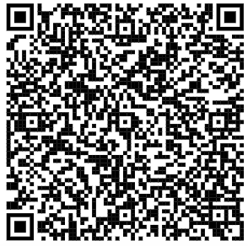
IMDRF / SAMD WG / N12 FINAL:2014
N12: Software as a Medical Device: Possible framework for risk categorization and corresponding considerations
N12 proposed a risk categorization framework for SaMD based on the state of the healthcare condition and the significance of information provided by the software
State of healthcare situation or condition | Significance of information provided by SaMD to healthcare decision
 | Treat or diagnose | Drive clinical management | Inform clinical management
Critical | IV | III | II
Serious | III | II | I
Non-serious | II | I | I

Slide 5
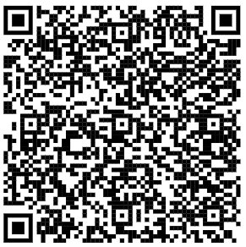
IMDRF / SAMD WG / N81 FINAL:2025
N81: Medical Device Software: Considerations for device and risk characterization
Builds on the initial concepts proposed in N12 by providing guidance on device and risk characterization
Introduces the broader term, “medical device software”
Acknowledges the broad range of technologies and characteristics that can influence risk, as well as the range of classification systems across global regulatory jurisdictions
Identifies unique software-specific risks
Not intended to replace existing IMDRF SaMD documents
“Medical device software”: any software that meets the definition of a medical device

Slide 6
IMDRF / SAMD WG / N81 FINAL:2025
N81 provides a common foundation
Robust device characterization supports risk characterization and device classification
01
02
03
CHARACTERIZE
UNDERSTAND RISK
INFORM DECISIONS
Understand what the device is; what it’s intended to do; where, when, & by whom it’s intended to be used and modified/changed
Identification of software-specific hazards and harms is supported by clear and comprehensive device characterization
Risk characterization concepts can be used by jurisdictions within their existing frameworks to inform classification decisions
A shared vocabulary can lead to greater consistency across jurisdictions

Slide 7

IMDRF / SAMD WG / N81 FINAL:2025
Why characterization matters
A comprehensive software characterization provides the foundation for:
    Risk assessment and risk management
    Evaluation of benefits
    Device classification and regulatory decision-making
    Clinical evaluation and supporting evidence requirements
    Labeling, transparency, and user understanding
    Change management throughout the product lifecycle

Slide 8
IMDRF / SAMD WG / N81 FINAL:2025
Core characterization elements
Intended use / intended purpose statement
The [name of medical device software] is software intended for use in the [medical purposes] of [conditions/diseases/disorders] in [intended patient populations]. This software is intended to be used by [intended user populations] in [intended use environments]. This medical device software is contraindicated for [contraindications]. This medical device software uses [inputs] in order to produce [description of outputs]. These outputs are [description of how the output is intended to be used, how it fits in the clinical or healthcare workflow and how it contributes to the final healthcare decision/action].

Slide 9
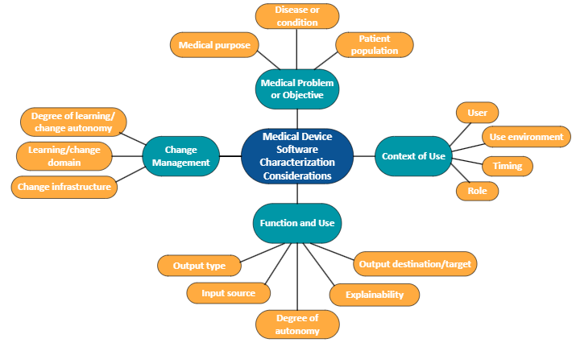
IMDRF / SAMD WG / N81 FINAL:2025
Core characterization elements
Medical device software description
A detailed medical device software description helps ensure the appropriate communication of all necessary information related to a medical device software, and is essential for consistent regulatory assessment

Slide 10
IMDRF / SAMD WG / N81 FINAL:2025
Medical Device Software Risk Characterization
Unique considerations for software-specific risk:
1
Software-related risks are often linked to information and performance, rather than traditional physical hazards
2
Harms can be direct (e.g., wrong treatment recommendation) or indirect (e.g., inaccurate information leading to poor clinical decisions)
3
In some cases, software can directly cause physical harm, particularly when it operates autonomously and influences patient care without user intervention
A thorough characterization of medical device software, including intended use, helps identify direct and indirect software-specific harms and how they contribute to overall device risk

Slide 11
IMDRF / SAMD WG / N81 FINAL:2025
N81 Implementation considerations
1
COMMON LANGUAGE
2
FLEXIBLE, RISK-BASED APPROACH
Common vocabulary for describing medical device software and software-specific risks
Jurisdictions may adopt relevant concepts within their existing frameworks
3
HARMONIZED FRAMEWORK
4
JURISDICTION-SPECIFIC
Harmonized framework to inform risk assessment and regulatory decision-making
Device classification remains the responsibility of individual jurisdictions and their applicable laws and regulations
N81 supports a shared understanding and consistency across jurisdictions

Slide 12
Health Canada perspectives on medical device software characterization and categorization

Slide 13
Applying Health Canada's Risk Classification to Medical Device Software
HIV test kit
Pacemaker
Heart valve
Neurovascular stent
Deep brain stimulator
CLASS IV
Surgical Robotics
Insulin pump
CT Scanner
Surgical Navigation SW
Computer Assisted Dx SW
CLASS III
CLASS II
TENS unit
Contact lens
Surgical gloves
Digital thermometer
Basic Radiology Image Analysis SW
CLASS I
Wheelchair
Hospital bed
Gauze bandage
Surgical /dental instrument
RISK and OVERSIGHT
In Canada, medical devices (including medical device software) are classified into Classes I to IV via the classification rules set out in Schedule 1 of the MedicalDevices Regulations

Slide 14
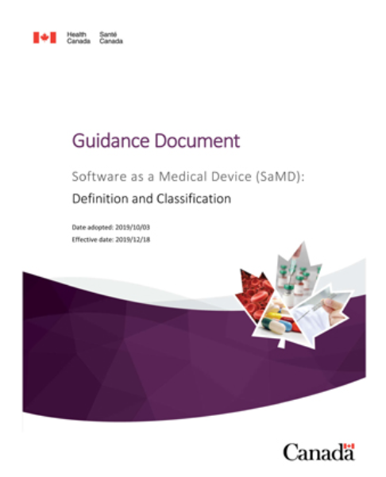
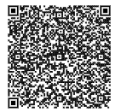
Health Canada SaMD Guidance
Health Canada’s 2019 Guidance, Software as a Medical Device (SaMD): Definition and Classification is intended to:
1
Clarify which software products are and are not considered medical devices
2
Provide information to determine the risk class, if the software is a medical device

Slide 15
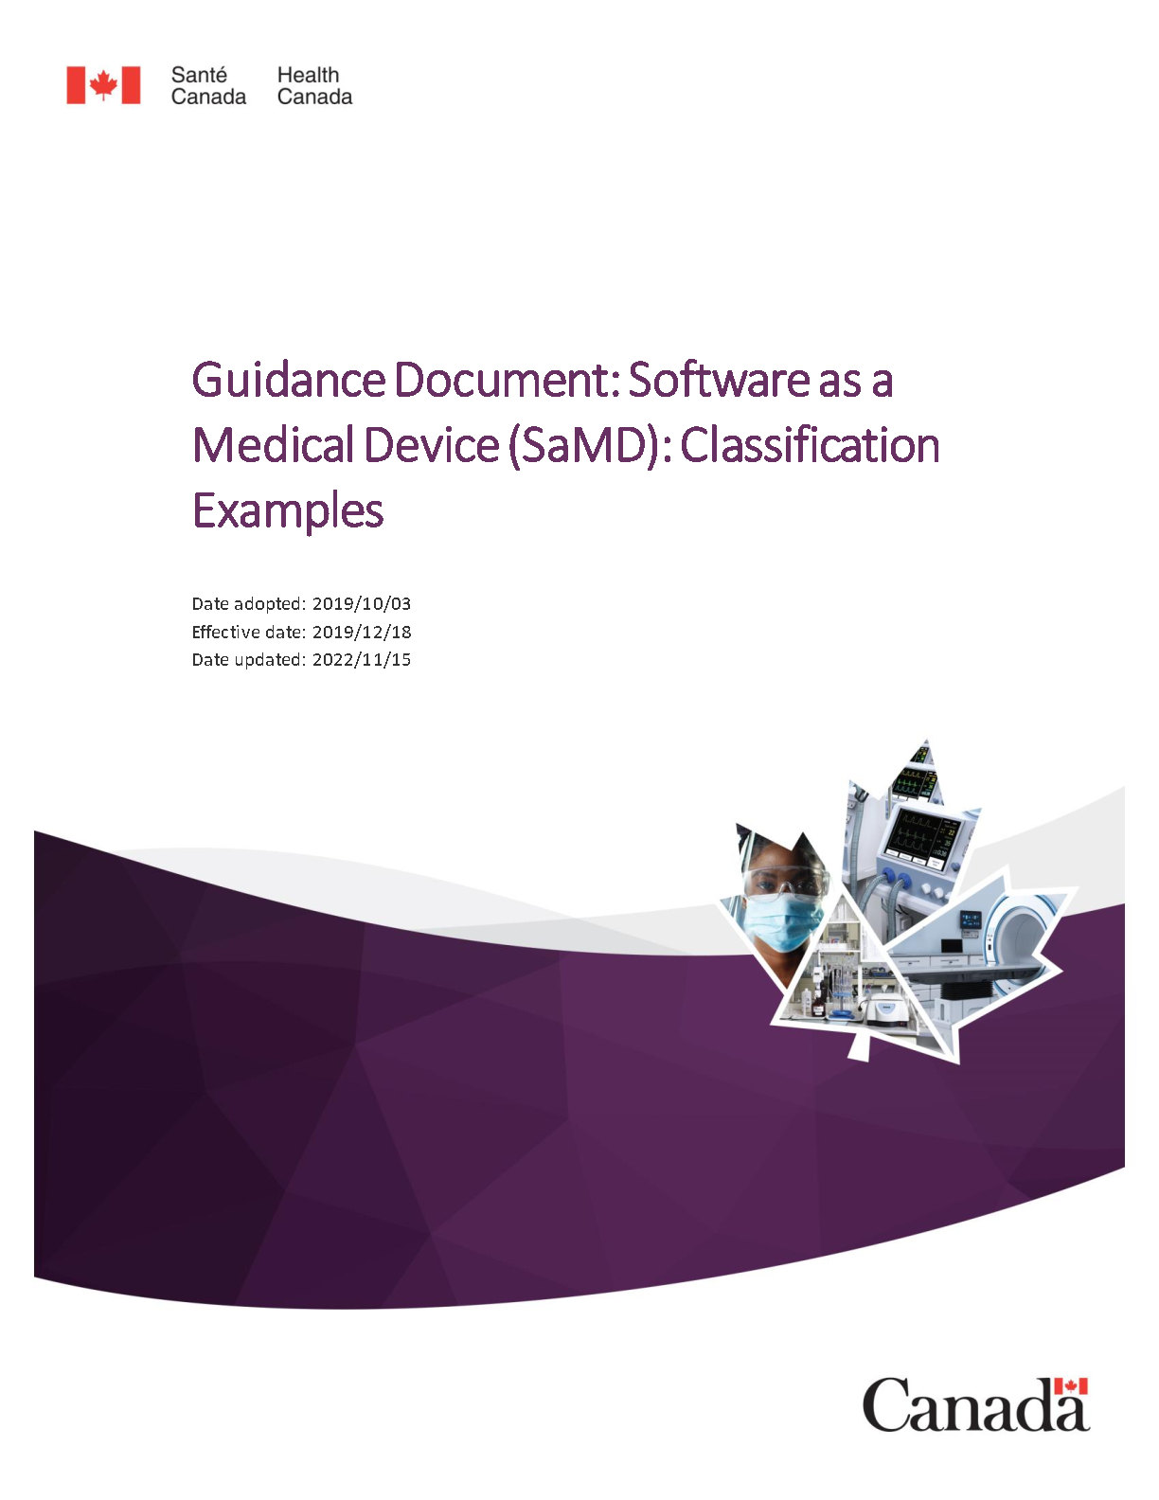
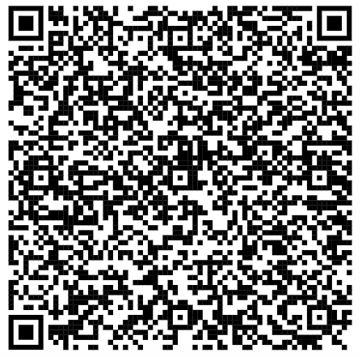
Companion document – SaMD Examples
Health Canada also published a companion document that provides softwareexamples and case studies to help determine if it is a medical device.
Software Product Examples | Determination
A risk calculator based on well-established, publicly available models to generate a score for obese individuals at risk of developing heart disease | Not a medical device
Picture Archiving and Communication System (PACS) | Not a medical device
Software that classifies screening mammography images into BI-RADS density categories to aid in the evaluation of individual breast cancer risk and decisions about any additional screening | Class II medical device
Software that performs image analysis for the detection of intracranial hemorrhage | Class III medical device

Slide 16
Thank you!
Questions?

