Slide 1



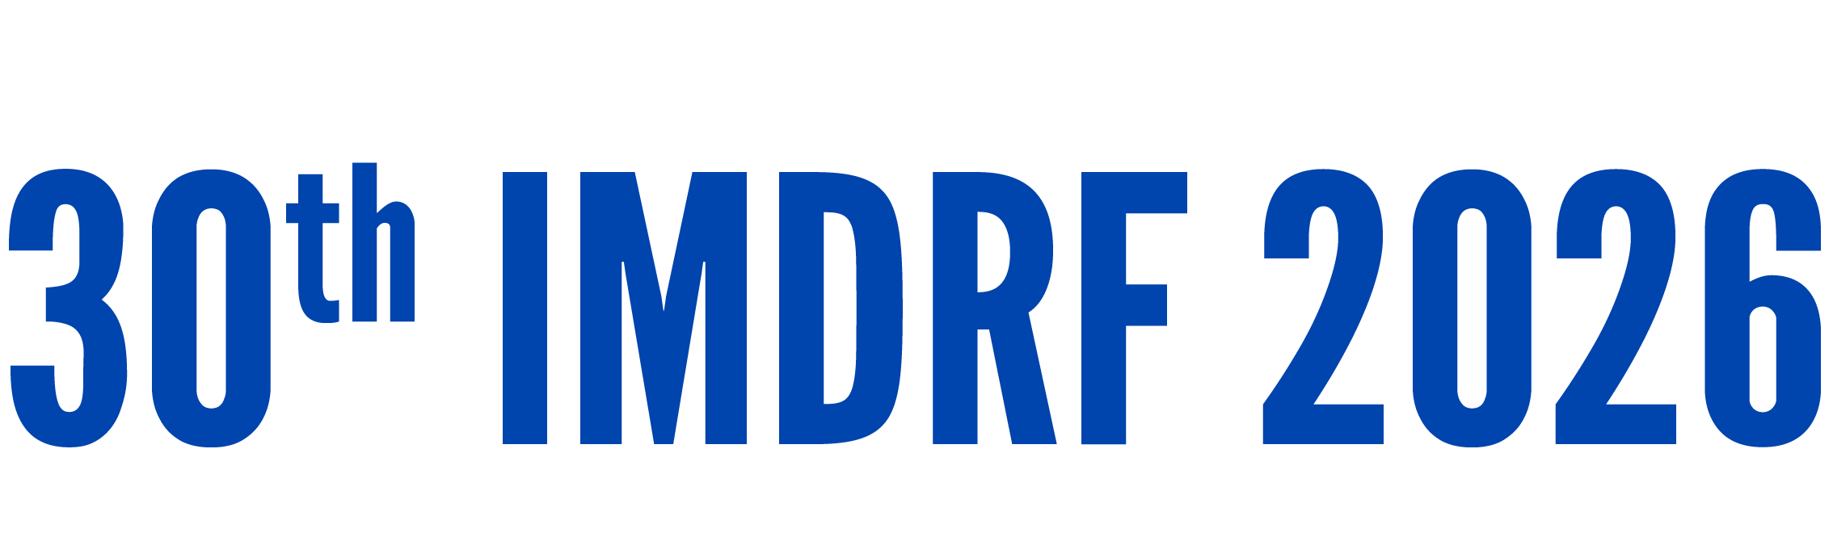
Day 1 IMDRF Industry Joint Workshop | 14 September 2026

Slide 2
Field Notes: Navigating Regulation Across Borders as a SaMD Manufacturer
Danny Kim, PharmD, MS · WELT
Day 1 IMDRF Industry Joint Workshop | 14 September 2026

Slide 3
INDUSTRY CASE STUDY · SESSION 1 FOCUS
Three messages
01
02
03
Managing classification differences across jurisdictions
Impact on regulatory pathways and evidence experience
Opportunities for convergence
The same insomnia CBT is graded five ways. The class number is not the problem — the evidence bar behind it is.
Other devices cross borders on a bridging study. SaMD often repeats the full trial — and no one says in advance how foreign data will be read.
Convergence is starting — under EU MDR Rule 11, DTx is now graded by risk, usually Class IIa rather than Class I. But while each country's evidence bar stays unwritten, the rest cannot follow.
Same intervention. Five verdicts. No exchange rate between them — yet.
Day 1 · IMDRF Industry Joint Workshop · 14 September 2026

Slide 4
PART A · CLASSIFICATION DIFFERENCES
The same intervention, graded five ways
Digital CBT for insomnia is the closest thing this field has to a controlled experiment: the same intervention, the same indication, nearly the same clinical content, authorized in five jurisdictions.
It gets graded five ways. Not a device in one. The lowest self-declared class in another. The middle class in three more. Every row here is from the regulators' own published mapping tables, not my reading.
Five class numbers would not matter if they meant the same work. They don't: each one sets a different evidence bar.
Day 1 · IMDRF Industry Joint Workshop · 14 September 2026

Slide 5
PART A · CLASSIFICATION DIFFERENCES
Same software, five different evidence bars
IMDRF country | Device class | Evidence bar to enter the market
Country 1 | Not a device | None — a CBT tool on published guidelines is outside device regulation.
Country 2 | Class I | Self-declaration; the clinical bar is set nationally, off the device route.
Country 3 | Class II | Foreign data accepted on GCP-equivalence; no population test named.
Country 4 | Class II | Full review, plus data shown representative of the domestic population.
Country 5 | Class II | Domestic data in practice; statute allows reliance on an OECD dossier.
Same software, five different bars, and no way to carry the work from one to the next.
Day 1 · IMDRF Industry Joint Workshop · 14 September 2026

Slide 6
PART B · IMPACT ON PATHWAYS AND EVIDENCE
Most devices cross on a bridging study. Software runs the trial again.
HOW OTHER MEDICAL DEVICES CROSS
HOW THERAPEUTIC SOFTWARE CROSSES
You localize the hardware, then validate the change: usability, human factors, localization.
The question is whether it still performs here, and there is a proportionate way to answer it.
The same localization reopens the efficacy question, and the safe answer is a fresh RCT.
The check meant for translation ends up re-proving the intervention itself.
In our own experience taking a therapeutic across markets, the request was the full trial again, with no written guidance on how the first market's data would count. That is the portability gap.
Day 1 · IMDRF Industry Joint Workshop · 14 September 2026

Slide 7
PART B · DUPLICATION OR DISCOVERY?
When we require a second study, can we say what it's for?
A digital therapeutic approved in one market on a solid pivotal trial reached a second market years later, and only after its local partner ran new domestic studies.
One study repeated the original design and fell short. Another, built differently, succeeded and read even stronger.
The foreign data was accepted, and it still was not enough. No one could have told you in advance which of the two studies was the one that mattered.
“I am not asking anyone to accept less evidence. I am asking that when we require a second study, we can say in advance what it is expected to find.”
Day 1 · IMDRF Industry Joint Workshop · 14 September 2026

Slide 8
PART C · OPPORTUNITIES FOR CONVERGENCE
We already share the factory audit. We've never shared the evidence.
Five regulators built MDSAP because none of them could inspect every factory. One quality-system audit now travels across all five.
That same programme tells its auditors to confirm only that a clinical evaluation happened, not whether the evidence behind it holds. The shared trust stops at the factory door.
MDSAP shows regulators can build structured trust and reuse each other's work. The open question is whether the same principles — transparency, comparability, reliance — could extend to clinical evidence.
Day 1 · IMDRF Industry Joint Workshop · 14 September 2026

Slide 9
PART C · WHY THE GAP PERSISTS
The rule everyone follows is the one nobody wrote down.
N41 gives software clinical evaluation a strong framework, but it does not set explicit principles for when evidence generated in one jurisdiction is transferable to another. Scan the full text for “transferability,” “generalizability,” “foreign,” “population transfer” and you find none of them.
So transferability falls to each jurisdiction's own requirements and case-by-case judgment. With nothing written to point to, the safe answer is another study — never wrong, and rarely questioned.
Several jurisdictions do have formal principles for accepting foreign clinical data. What stays unevenly defined is the practical criterion: when is SaMD evidence transferable enough across populations, health systems and workflows? That undefined bar is the problem.
Day 1 · IMDRF Industry Joint Workshop · 14 September 2026

Slide 10
PART C · THE ASK
Small, concrete, and inside this forum's authority
1
PUBLISH THE BAR
2
ANCHOR TO A SHARED FRAMEWORK
Each jurisdiction states, per N12 risk class, the clinical evidence it expects — and its stance on data generated abroad.
Anchor those bars to an internationally aligned, risk-based framework — building on N12 and informed by N81 — so comparable characterization and risk mean comparable evidence.
3
A LANE FOR LEGACY
4
THE BIGGER QUESTION
Products approved under older rules get a grace period to meet a higher class, supported by real-world data instead of a fresh trial.
The larger need is not inspecting sites but regulators being able to rely on each other's scientific assessment of the evidence — a conversation for another day.
None of this asks for weaker evidence. It asks that the bar be written down, and tied to a shared risk-based framework.
Day 1 · IMDRF Industry Joint Workshop · 14 September 2026

Slide 11
FOR THE PANEL
Questions for discussion
1
Could the reliance MDSAP built for quality systems ever extend to the scientific assessment of clinical evidence?
2
Would publishing each jurisdiction's evidence bar, by N12 class, be feasible — and who would own it?
3
For products approved under older rules, is there appetite for a real-world-data route to a higher class, instead of a repeat trial?
Day 1 · IMDRF Industry Joint Workshop · 14 September 2026

Slide 12
Thank you!
Questions?

