Slide 1



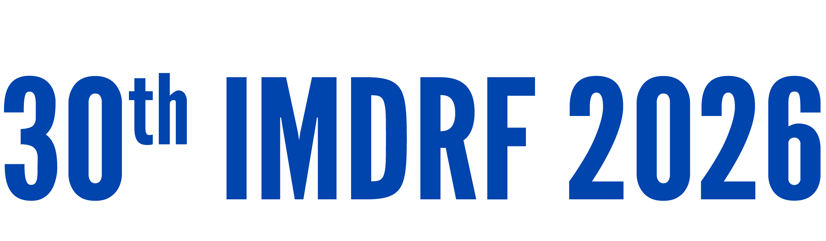
Day 1 IMDRF Industry Joint Workshop | 14 September 2026

Slide 2
Software Characterization and Risk Categorization – From Guidance to Practice
Mahesh Datar
Sr Manager, Regulatory Affairs, Medtronic Australasia
DITTA

Slide 3
AGENDA
1. IMDRF frameworks for software categorization
2. Regulatory implementation across jurisdictions
3. Industry experience and impact on patient access
4 Opportunities for convergence

Slide 4
IMDRF Frameworks for
Software Characterisation

Slide 5
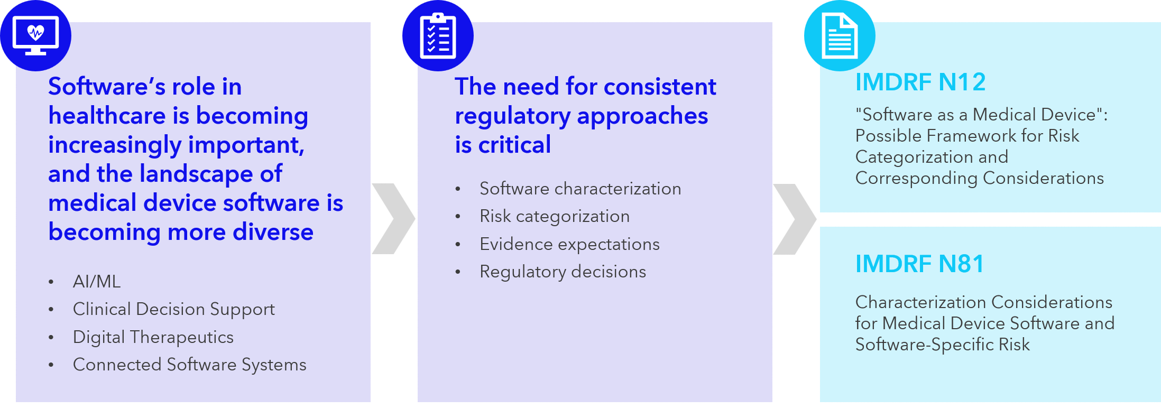
Aim is to establish a common foundation for SaMD classification and characterisation

Slide 6
IMDRF N12
“Software as a Medical Device": Possible Framework for Risk Categorization and Corresponding Considerations
State of healthcare situation or condition | Significance of information provided by SaMD to healthcare decision
 | Treat or diagnose | Drive clinical management | Inform clinical management
Critical | IV | III | II
Serious | III | II | I
Non-serious | II | I | I

Slide 7
IMDRF N12
Scope Considerations
Quote from the “scope (header: Relationship to other regulatory classification and standards)”
This document is not intended to replace or create new risk management practices rather it uses risk management principles (e.g., principles in international standards) to identify generic risks for SaMD.
The categorization framework in this document is not a regulatory classification, nor implies a convergence of classifications rules. However, it does set a path towards common vocabulary and approach. Additional work is required to align existing classification rules with this framework.
The categorization framework is not meant to replace or conflict with the content and/or development of technical or process standards related to software risk management activities..​

Slide 8
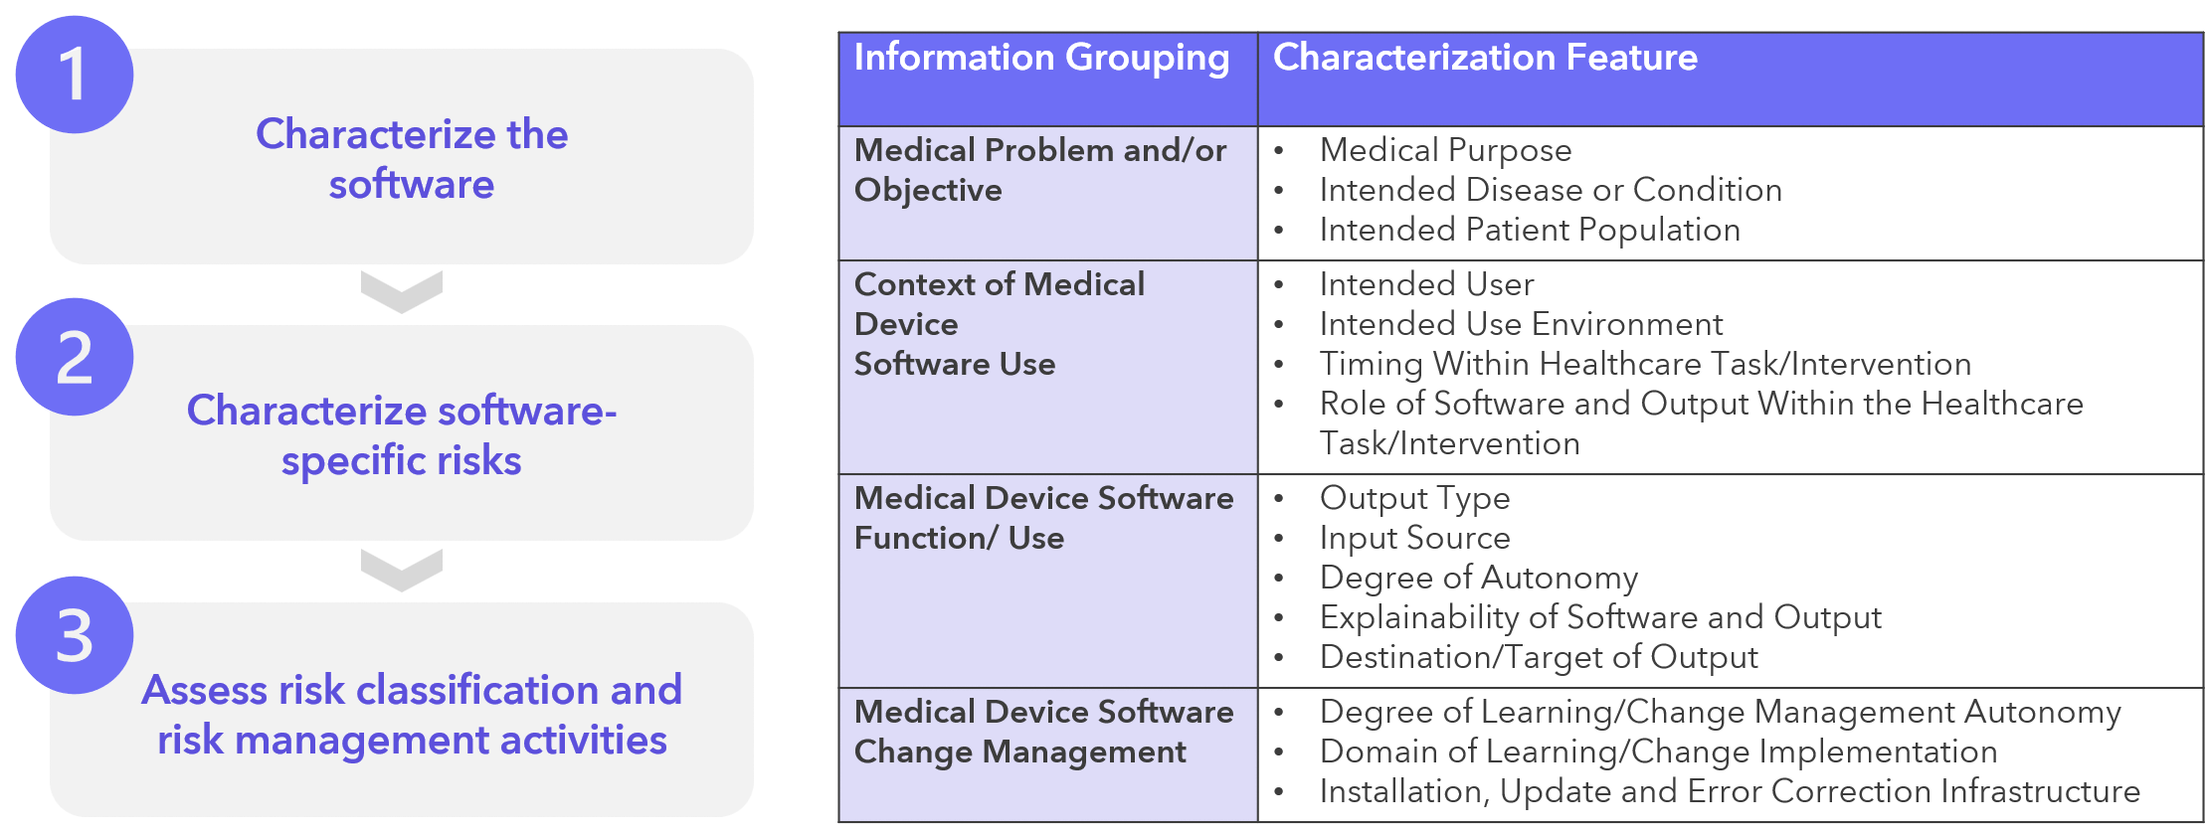
IMDRF N81
Characterization Considerations for Medical Device Software and Software-Specific Risk

Slide 9
IMDRF N81
Scope Considerations
Quote from the “scope”
This document is not intended to replace IMDRF SaMD WG N12 "Software as a Medical Device": Possible Framework for Risk Categorization and Corresponding Considerations.
This document is not intended to provide guidance on the classification of devices.
The content in this document is not regulation or guidance and does not imply a convergence of regulations or categorization rules across jurisdictions. However, this document aims to establish harmonized concepts, considerations, and common vocabulary for the risk characterization of medical device software. Additional work may be required to apply and align these concepts in a given jurisdiction.

Slide 10
Regulatory Implementation across Judistrictions

Slide 11
Regulatory implementation across judistrictions
IMDRF N12 and N81 provide a common framework, but harmonisation is a challenging task
Factors contributing to variation
Application of jurisdiction-specific classification rules
Existing regulatory guidance and review precedent
Interpretation of software characteristics (and outcomes)

Slide 12
Industry Experience and Impact on Patient Access

Slide 13
Case Study 1 – Company A
Product – SaMD (processing outcomes from a single implantable medical device)
IMDRF Regulator A | IMDRF Regulator B | IMDRF Regulator C | IMDRF Regulator D | IMDRF Regulator E
Class IIb | Class II | Class II | Not yet applied | Class II / III?
Reason for differences | Impact on evidence requirements | Outcome
Difference of interpretation for Outcomes + HCP influence in decision making | Expanded review of risk and clinical evaluation evidence | 6–12-month difference for patient access

Slide 14
Case Study 2 – Company A
Product – SaMD (processing outcomes from a sensor and sending it to patient app / SaMD)
IMDRF Regulator A | IMDRF Regulator B | IMDRF Regulator C | IMDRF Regulator D | IMDRF Regulator E
Class IIa | Class II exempt | Non-Medical Device | Class A | Class III
Reason for differences | Impact on evidence requirements | Outcome
Difference of interpretation for Outcomes + familiarity and awareness of the disease state due to the disease state being an ongoing condition | Required generating different evidence requirements | 24-month difference in patient access

Slide 15
Case Study 3 – Company B
Product – Secondary alarm reporting software connecting multiple sensors
IMDRF Regulator A | IMDRF Regulator B | IMDRF Regulator C | IMDRF Regulator D | IMDRF Regulator E
Class IIb | Class II | Class I | Class C | Class III
Reason for differences | Impact on evidence requirements | Outcome
Involved aggregation, prioritization, and communication of alarms from multiple primary medical devices to one SaMD, despite the fact that alarm prioritization and escalation criteria are typically established by healthcare providers according to local clinical protocols rather than being predetermined by the manufacturer. | Required generating different evidence requirements | 12-month difference in patient access

Slide 16
Case Study 4 – Company B
Product – Medical Device Data System (MDDS) Software
IMDRF Regulator A | IMDRF Regulator B | IMDRF Regulator C | IMDRF Regulator F
Non-Medical Device | Non-Medical Device | Non-Medical Device | Class II
Reason for differences | Impact on evidence requirements | Outcome
MDDS software is classified as medical software as this regulator considers medical device data handling as a medical function. | Technical File with higher level of evidence requiring compliance to regulations is required compared to a non-medical device | 12-month difference in patient access

Slide 17
Case Study 5 – Company C
Product – Clinical Decision Support Software (CDSS) - Chronic disease follow-up assistant embedded in EHR
IMDRF Regulator A | IMDRF Regulator B | IMDRF Regulator C | IMDRF Regulator G
Exempt CDSS | Non-Medical Device | Non-Medical Device | Class II
Reason for differences | Impact on evidence requirements | Outcome
The software provides information used to take decisions with diagnosis or therapeutic purposes, the baseline classification is Class IIa | Technical File with higher level of evidence requiring compliance to regulations is required compared to a non-medical device | 12-month difference in patient access

Slide 18
Theme arising from the Case Studies
Uncertainty/
confusion
around level of
evidence
Raising the bar
for evidence
requirements
Add in new +
inexperienced
manufacturers for
SaMD
Delayed
patient access

Slide 19
Path Forward and Opportunities for Convergence

Slide 20

Opportunities for Convergence
Practice reliance despite classification differences
Support regulatory reliance when software characterization and supporting evidence are comparable, even if device classifications differ across jurisdictions, to reduce duplication while maintaining appropriate regulatory oversight.
Shift the focus from classification to evidence
Promote flexible, risk-based reliance frameworks that evaluate the quality and relevance of the manufacturer's evidence based on the software-specific risk characterization, rather than relying solely on device classification.
software that independently interprets clinical data or drives clinical actions may warrant higher classification; a distinction should be made for systems that operate using healthcare provider-defined rules and workflows.
Define pathways to bridge classification gaps
Develop guidance describing how additional evidence, such as real-world evidence or supplementary conformity assessment documentation, can support reliance when classifications differ.
Promote consistent implementation
Support capacity building, best practices, and shared interpretation to promote more consistent interpretation / implementation of IMDRF N12 and N81 across jurisdictions.

