Slide 1




Day 1 IMDRF Industry Joint Workshop | 14 September 2026

Slide 2
Software Classification/Characterization and Risk Categorization – Europe -
Dr. Matthias Neumann
Unit - Medical Devices Law
Federal Ministry of Health Germany
Day 1 IMDRF Industry Joint Workshop | 14 September 2026

Slide 3
Overview
1
Historic development of the software classification rules
Current Rules and Guidance
Possible Changes and specific considerations for AI classification
2
3

Slide 4
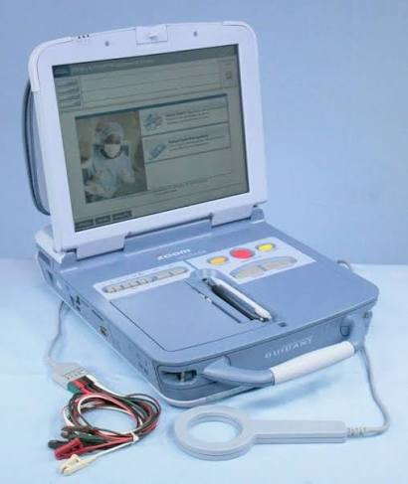
Historic development of the software classification rules
1993: (a) 'medical device' means any instrument, apparatus, appliance, material or other article, whether used alone or in combination, including the software necessary for its proper application intended by the manufacturer to be used for human beings for the purpose of:
diagnosis, prevention, monitoring, treatment or alleviation of disease, ……….
Standalone Software was missing
Placing on the market was only possible as part of a hardware device (integrated in an active device or running on a “medical” computer)

Slide 5
Historic development of the software classification rules
2007: ‘medical device’ means any instrument, apparatus, appliance, software, material or other article, whether used alone or in combination, including the software intended by its manufacturer to be used specifically for diagnostic and/or therapeutic purposes and necessary for its proper application, intended by the manufacturer to be used for human beings for the purpose of:
— diagnosis, prevention, monitoring, treatment or alleviation of disease,
SaMD Software as Medical Device - Standalone Software – may run on PC, notebooks, smartphones etc.
SiMD Software in a medical device can be placed on the market as a separate medical device (if the software has a medical purpose)

Slide 6
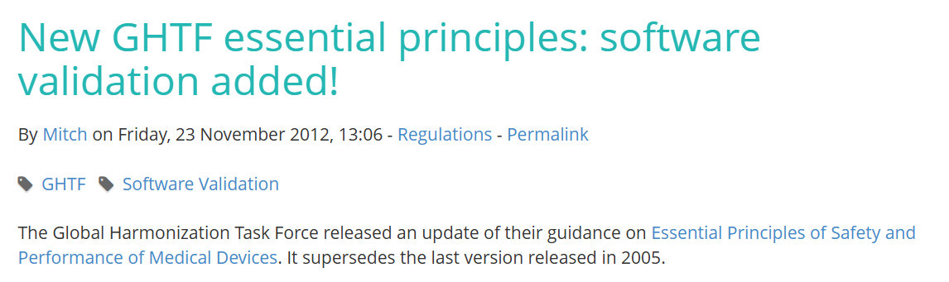
Historic development of the software classification rules
2007:
SaMD and SiMD defined
First time ever: a regulatory essential requirement on safety and performance of software was introduced (software validation, lifecycle approach etc,) the same requirement was 5 years later added to GHTF essential requirement document
But no specific classification rule(s)
Implementation rule Annex VIII 2.3.: Software, which drives a device or influences the use of a device, falls automatically in the same class.
Rules for active devices (Annex VIII rules 9-12 ) have been used for medical software
Rule 9 diagnostic devices (IIa- IIb) , rule 10 therapeutic devices (IIa-IIb), rule 11 devices administrating/removing medicines/substances etc. (IIa-IIb), rule 12 all other active devices class I

Slide 7
Current software classification rules MDR (EU) 2017/745
New Rule 11 states:
Software intended to provide information which is used to take decisions with diagnosis or therapeutic purposes is classified as class IIa, except if such decisions have an impact that may cause:
      death or an irreversible deterioration of a person's state of health, in which case it is in class III;
      or a serious deterioration of a person's state of health or a surgical intervention, in which case it is classified as class IIb.
Software intended to monitor physiological processes is classified as class IIa, except if it is intended for monitoring of vital physiological parameters, where the nature of variations of those parameters is such that it could result in immediate danger to the patient, in which case it is classified as class IIb.
All other software is classified as class I

Slide 8
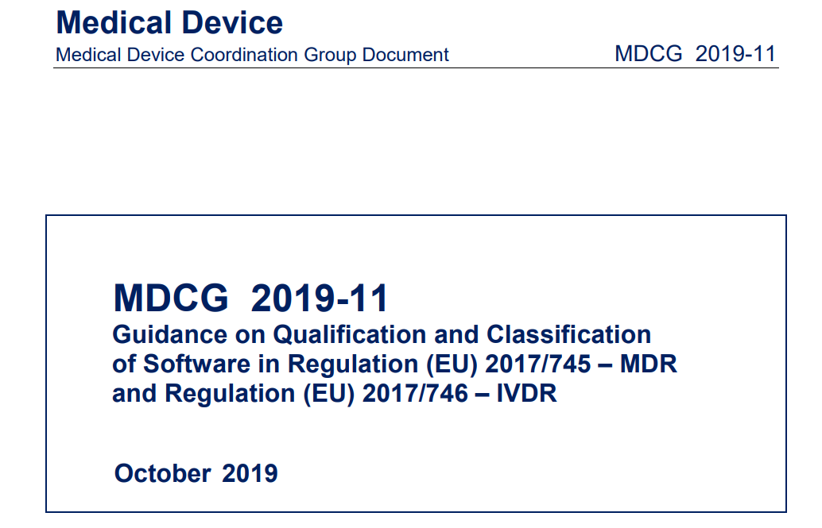
Guidance on current software classification rules MDR (EU) 2017/745
Guidance document that provides software examples and case studies to help determine if it is a medical device and how the classification rules should be applied.

Slide 9
Guidance on current software classification rules MDR (EU) 2017/745
Definition – Medical device software -
the term “standalone software” which was used under the Medical Devices Directive , is no longer used in the context of the Medical Device Regulations. The rationale of the change is that software should be qualified and classified depending on its intended purpose uniquely, regardless of its location (i.e. embedded, operating on a platform, on the cloud, etc.).
Medical Device Software (MDSW) MDSW: is software that is intended to be used, alone or in combination, for a purpose as specified in the definition of a “medical device” in the medical devices regulation or in vitro diagnostic medical devices regulation.

Slide 10
Guidance on current software classification rules MDR (EU) 2017/745
Special considerations on Implementing Rule 3.3 and 3.5 of Annex VIII
The first sentence clarifies the regime applicable to software driving or influencing the use of a device:
‘Software, which drives or influences the use of a device, shall fall within the same class as the device’
The second sentence clarifies that the regime applicable to Independent MDSW: ‘If software is independent of any other device, it shall be classified in its own right’
Implementing rule 3.5 states that ‘If several rules, or if, within the same rule, several sub-rules, apply to the same device based on the device’s intended purpose, the strictest rule and sub-rule resulting in higher classification will apply’
Example:
Melanoma image analysis software intended to be used with a near-infrared laser light scanner, which is considered class IIa per Rule 10. The software “drives or influences the use of” the near-infrared laser light scanner as it is intended to take control of the scanner by letting it execute proprietary multi-exposure programs for the detection of melanoma. As such, implementing rule 3.3 applies. However, Rule 11 would also apply based on the intended medical purpose of the software e.g. cancer diagnosis. The MDSW would be classified as class III based on Rule 11 and per implementing rule 3.5 of Annex VIII.

Slide 11
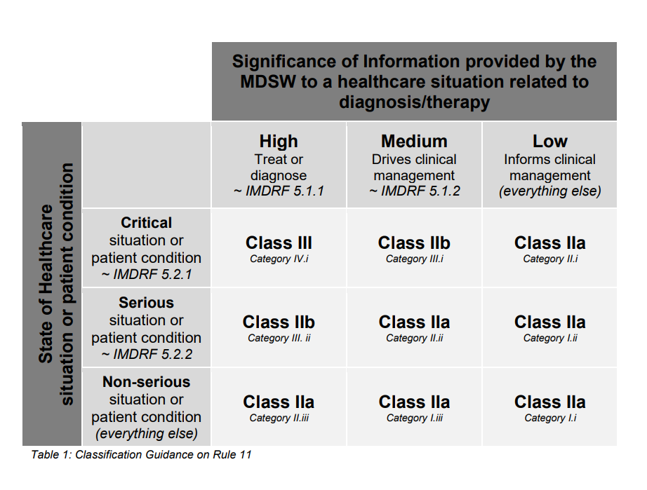
Guidance on current software classification rules MDR (EU) 2017/745
N12: Software as a Medical Device: Possible framework for risk categorization and corresponding considerations

Slide 12
Possible changes on software classification rules MDR (EU) 2017/745
Rule 11
Software which is intended to generate an output that confers a clinical benefit and
is used for diagnosis, treatment, prevention, monitoring, prediction, prognosis,
compensation or alleviation of a disease or condition is classified as class I, unless
the output is intended for a disease or condition:
– in a critical situation with a risk of causing death or an irreversible
deterioration of a person's state of health, in which case it is classified as class III;
– in a serious situation with a risk of causing a serious deterioration of a
person's state of health or a surgical intervention, or to drive clinical management
in a critical situation in which cases it is classified as class IIb;
– in a non-serious situation, or to drive clinical management in a serious
situation or to inform clinical management in a critical or serious situation in which
cases it is classified as class IIa.’;

Slide 13
Possible changes on software classification rules MDR (EU) 2017/745
Medical device AI systems (both those intended to be used as a safety component or those which are themselves AI systems) are classified as class IIa, except:
if they are continuously learning in the field and are overseen by the intended user, they are classified as class IIb;
if they are continuously learning in the field and operate conditionally independent or independent from the intended user’s oversight, they are classified as class III.’;
Rationale
The European AI-Act requires for critical AI Systems the involvement of a Notified Body into the conformity assessment procedures. To ensure the same/similar level of regulatory control also MD-AI must be classified at least as a class IIa

Slide 14
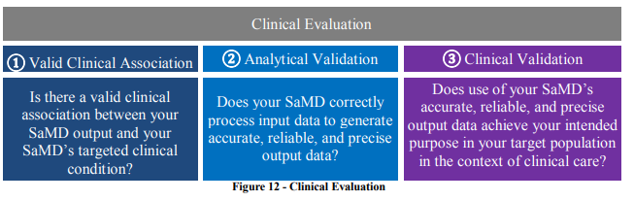
Why are differences in risk classification causing delays in patient access for more than 6 to 24 months ?
Is it really the classification and the resulting regulatory pathway (self-declaration, QMS certificate, Pre-market approval, TD-Assessment by a Notified Body)?
No, ?
E.g. with the new Regulation (EU) 2026/977 The Notified Body must complete the assessment (and issue a certificate) within a maximum of 120 days from the date of a complete submission.
Are different classifications causing different levels of clinical evaluation or different levels of expectations on the clinical evidence?
No?
Clinical evaluation is always
necessary.
Also a clinical evidence and
an acceptable benefit/risk ration
IMDRF/SaMD WG/N41FINAL:2017
SaMD: Clinical Evaluation

Slide 15
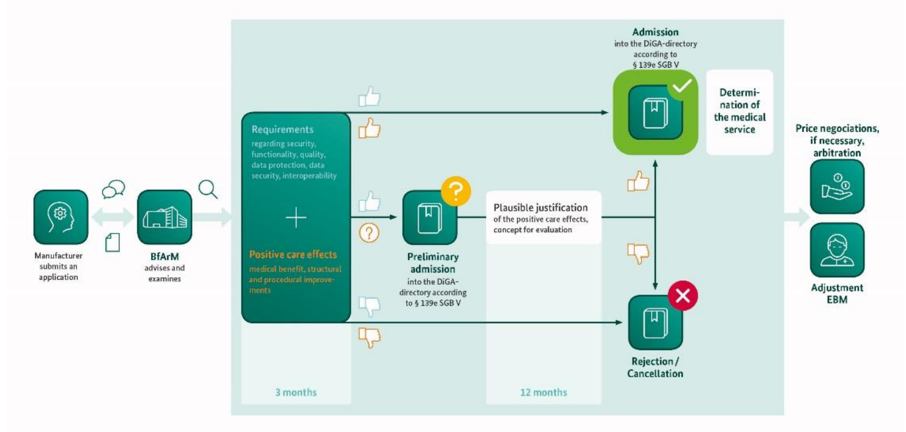
Why are differences in risk classification causing delays in patient access for more than 6 to 24 months ?
?
Is the classification of software determining the time for reimbursement decisions?
Possibly yes.
German fast track reimbursement procedure for low/medium risk Digital Health apps

Slide 16
Where to go ? (to increase possible reliance)
More software should be classified as class I ???
Reducing requirements on clinical evaluation ???
Providing more suitable guidance on clinical evaluation of software (including real world evidence etc.) and in particular on the clinical evaluation of AI-based Medical devices software?

Slide 17
Thank you!
Questions?

