Slide 1




Day 1 IMDRF Industry Joint Workshop | 14 September 2026

Slide 2
Patient Involvement in Digital Health Technologies
Ai Ling Sim-Devadas
Deputy Director, Office of Patient Engagement (OPEN),
Lee Kong Chian School of Medicine, NTU Singapore

Slide 3
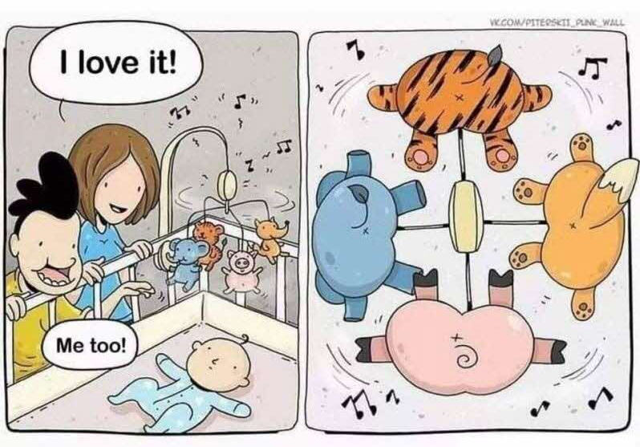
Why patient involvement in healthcare innovation?
Staff view
Patient view

Slide 4

What do patients and caregivers think about the use of digital health technologies?
How do they feel about it?
Notes:
Patients' perspectives on digital health tools
Technological advancements have enabled online health services, such as remote monitoring and consultations. These technologies and services have allowed greater access to services irrespective of geographical loca tion while helping patients have a more active role in their clinical treat ment. This active role can be interpreted as patient engagement, patient involvement,patientadherence,andcompliance[4].Despitethis,fewstud ies, have focussed attention on consumers' or patients' perspectives with respect to digital health solutions, despite the low uptake and accep tance by patients [5]. Digital tools, such as patient portals, mobileappli cations, and wearable technologies bring convenience [6], provide patients with easier access to their health records and clinical expertise, and make collecting health data less intrusive. This could lead to better patient experiences [7] and could potentially shift the patient-provider relationship from a paternalistic model to a patient-centred model [8,9]. Despite digital health tools being designed for patients' perceived needs, it appears that they have rarely involved patients in the design process from the early stages [10], and there is a lack of attention to their perspectives [11]

Slide 5

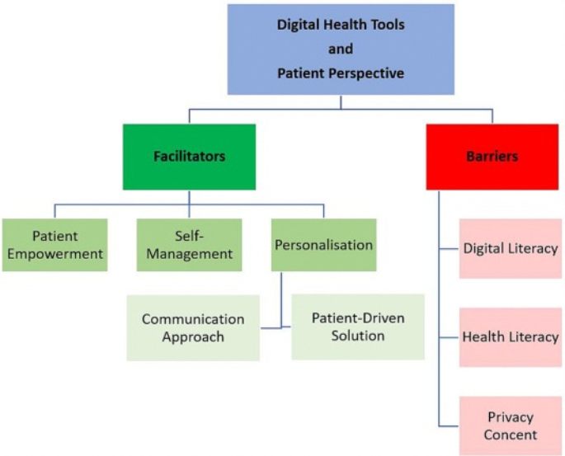
Samaneh Madanian, Ivana Nakarada-Kordic, Stephen Reay, T'heniel Chetty, Patients' perspectives on digital health tools, PEC Innovation, Volume 2, 2023, 100171, ISSN 2772-6282, https://doi.org/10.1016/j.pecinn.2023.100171.

Slide 6
Patient Concerns on Digital Health
Good to have more accessible tools and information
What if my data gets stolen?
Is this information accurate and reliable?
What if it's too difficult for me to use?
Where can I get quick answers for my urgent needs?
I feel safer knowing that I'm monitored by a professional
Who gets to see my data?
And many more…

Slide 7

"We found that patient factors are rarely incorporated or reported in medical AI research, are limited in scope and are largely confined to late-phase clinical validation."
Lai, S., Guan, Z., Zhang, Y. et al. Patient factors in medical artificial intelligence: a systematic review. Nat. Health (2026). https://doi.org/10.1038/s44360-026-00190-2

Slide 8
How may we do it well?
Shifting Mindsets
Embrace patient involvement to shape or co-design the solution from the start of the project, not later or as an afterthought.
Commitment to develop a patient partnership culture
Shifting Research
Patient and Public Involvement (PPI) and co-design methodologies to build trust and safety in medical AI and digital health technologies.
Capability building of researchers and developers on patient involvement and co-design
Investment in resources and processes to embed patient involvement into medical AI and digital health technologies research and development.

Slide 9

Involving patients in digital health development
Moving patients from participant to partners in research and health solution development
An active partnership between patients and the public and researchers and healthcare professionals in the solutioning process, rather than the use of people as passive ‘users’.
Patient and public involvement is often defined as working on solutions ‘with’ or ‘by’ people who use services rather than ‘to’, ‘about’ or ‘for’ them.

Slide 10



Consultation
vs Collaboration vs
Co-production
Co-production
Collaboration
More integrated approach where patients and the public are involved as equal partners in the design, delivery, and evaluation of services. It goes beyond consultation and collaboration by embedding stakeholders in the entire process.
Shared decision-making from the outset, with stakeholders actively participating in all phases of service development (eg. deliberative events, and ongoing dialogue to facilitate meaningful engagement)
Involves working together with stakeholders, including patients, healthcare professionals, and managers, to develop solutions or make decisions through shared responsibility and mutual influence.
Two-way communication: Stakeholders actively engage in discussions and joint decision-making processes, where all parties have a say in shaping outcomes (eg. Workshops)
Consultation
Healthcare providers seek input from patients or the public on specific issues or proposals.
Often one-way communication: Information is presented to stakeholders, who then provide feedback. (eg. Surveys, public meetings, or focus groups)

Slide 11







Collaborator for research projects
Develop research questions and priorities
Involvement in study design
Member of Patient Advisory Groups for research and clinical trials
How Patient Partners are involved in the research eco-system
Review of research proposal
Co-author for journal article
Review of patient-facing materials for research
Co-researcher
Sharing of lived experiences at conference & seminars
Members of research panels & committees

Slide 12
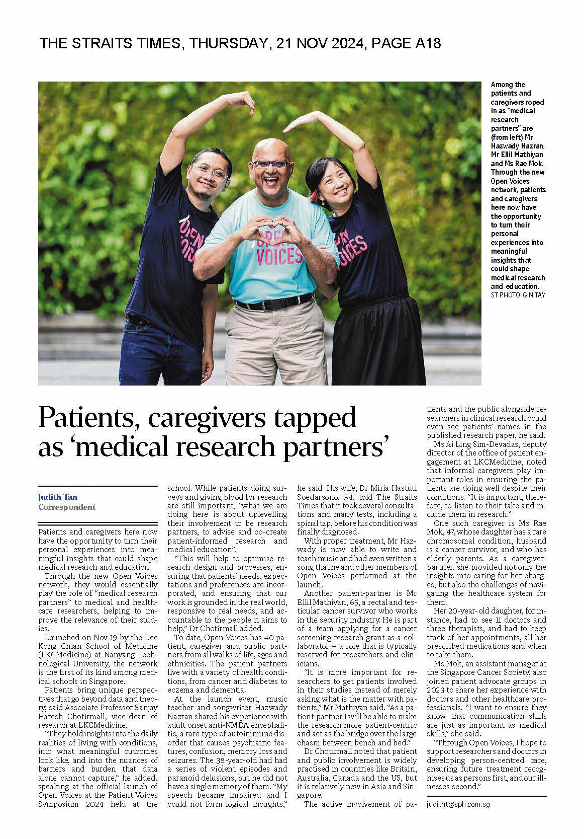
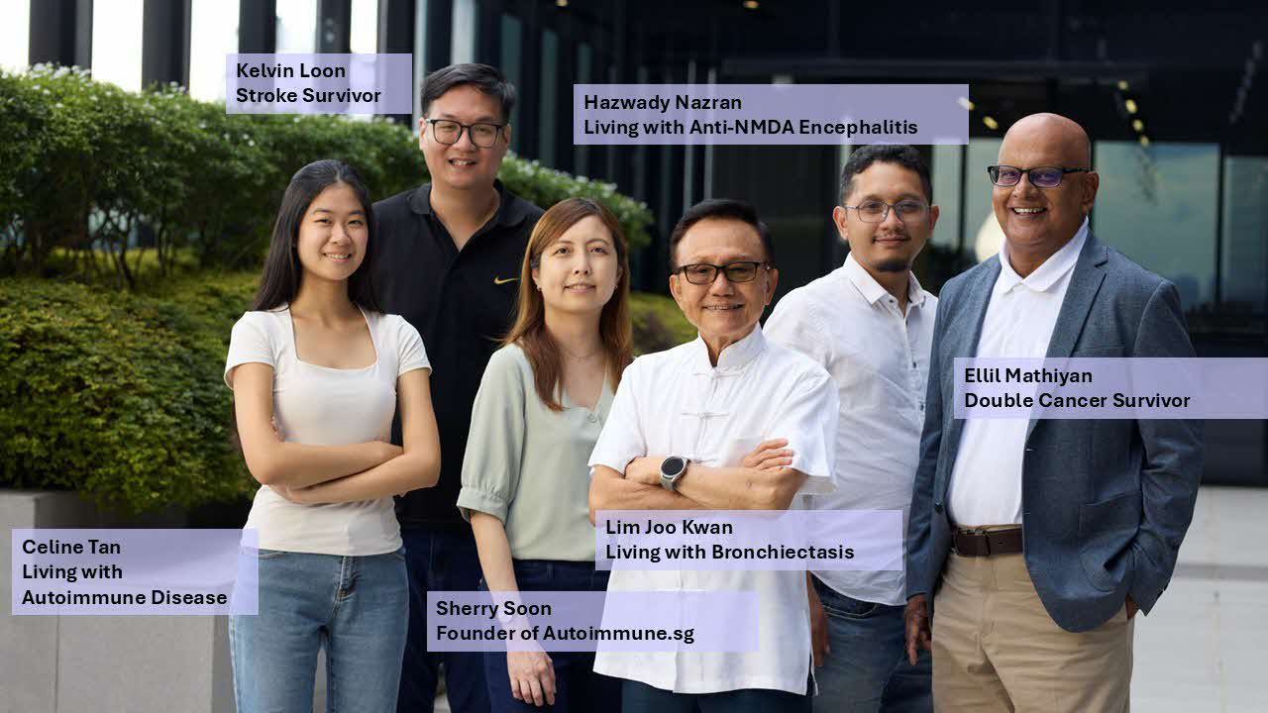
Office of Patient Engagement (OPEN) at LKCMedicine
We are the CATALYST for integrating patient and public voices into healthcare solutions, research and medical education.
We EMPOWER patient partners as active contributors to healthcare transformation through medical research and education.
Enable Advocate Partner Empower

Slide 13


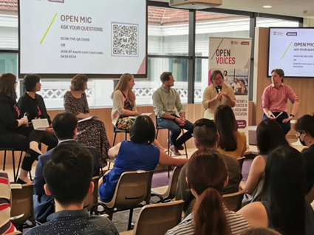
OPEN is transforming research practices and mindsets, fostering the growth of patient partners
Patient Partnership as our True North
Enabling Patient Public Involvement (PPI)
Open and collaborative culture
Capability Building for patients, researchers and clinicians
Partnership through OPEN Voices
(70 patient partners) & 30 patient organisations
Works hand-in-hand with researchers and educators to integrate PPI into their projects
Relationship building with patient partners focused on respect, support, inclusion, diversity, accessibility, learning and growth.
Patient Voices Symposium
OPEN Conversation seminars
PPI 101 Workshop
Patient as Research and Education Partner (PREP ) Workshop
.
>30 Patient and Public Involvement (PPI) research, education and engagement projects per year
>75 OPEN Voices patient partners

Slide 14

Call to: clinicians, researchers and industry to involve
patient and caregiver partners in solutions processes
Paradigm shift in patient partnership
Create sustainable pathways and access to involve patient and caregiver partners
Grow capability and capacity in PPI among your team to involve patient and caregiver partners confidently
Invest in patient involvement

Slide 15

Asking "What matters to you?"
Makes a patient and caregiver feel part of the process and prioritises their thoughts, needs, and concerns.
This is part of the healing process and is where solutions can be found!

Slide 16

Call to Action
Involve & Co-Design with
Patients and Caregivers

Slide 17
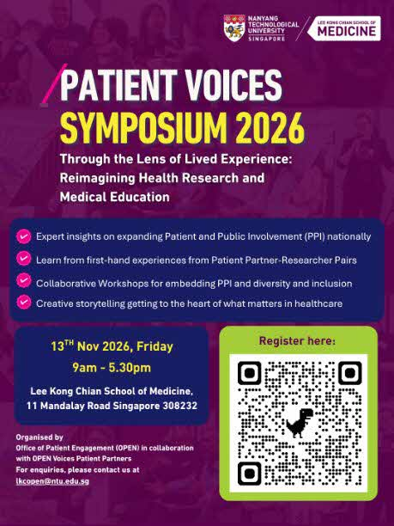
Interested in learning more about PPI? Join us for
Patient Voices Symposium 2026!
13 November 2026
9am – 5.30pm

Slide 18

Growing the patients’ voice
To stay connected:
Ailing.simdevadas@ntu.edu.sg
LKCOpen@ntu.edu.sg

