Slide 1




IMDRF Workshop Day 1 | Session 2 | 14 September 2026

Slide 2


Artificial Intelligence / Machine Learning Working Group Update
Working Group Chair(s):​
Gabriela Commatteo, Medicines and Healthcare products Regulatory Agency (MHRA), United Kingdom
Danielle Faruq, Food and Drug Administration (FDA), United States of America

Slide 3
Background to the AI/ML Working Group
Co-chaired by the UK’s Medicines and Healthcare products Regulatory Agency (MHRA) and USA Food and Drug Administration (FDA), contact: imdrf-aiwg@fda.hhs.gov
Members include both regulators and industry stakeholders:
Argentina, Australia, Brazil, Canada, European Union, Global Diagnostic Imaging, Healthcare IT and Radiation Therapy Trade Association (DITTA), Global Harmonization Working Party (GHWP), Global Medical Technology Alliance (GMTA), Israel, Japan, Kenya, Singapore, South Africa, South Korea, Switzerland, Taiwan, United Kingdom, United States of America, Zambia
Published documents:
N88: ‘Good machine learning practice for medical device development: Guiding principles’ (2025)
Ongoing work:
N93: ‘Framework for Artificial Intelligence Life Cycle Management’ (anticipated 2027)

Slide 4
N93: Framework for Artificial Intelligence Life Cycle Management (anticipated publication Spring 2027)
Building upon the N88 ‘Good machine learning practice for medical device development: Guiding principles’ (2025) the N93 provides a harmonised technical framework detailing considerations for AI-enabled medical devices across the total product life cycle. The guidance comprises:
Universal concepts that apply throughout the life cycle, including quality management systems (QMS); risk management; human oversight; and cybersecurity.
Life cycle stages that operationalise concepts, including planning and design; data collection and management; model building and tuning; verification and validation (including clinical evaluation); deployment; operations and monitoring; real-world performance evaluation; and sunsetting.
Transparency and labelling to support the informed and appropriate use of AI-enabled medical devices, including as products are updated across their life cycle.

Slide 5
Consultation Feedback: Themes and Progress
Public consultation was open between 10 April and 10 July 2026, receiving over 500 individual comments from across 26 organisations. Top feedback themes include:
Validation, Verification & Performance Metrics
Transparency & Explainability
Deployment & Localisation
Risk Management & Benefit-Risk
Human Oversight
Generative AI / LLMs / Foundation Models
Comment resolution is currently underway between the MHRA, FDA and volunteer WG members, with final draft submission to the Management Committee anticipated for Spring 2027 (31st Meeting)

Slide 6
Updates from the National Commission into the Regulation of AI in Healthcare
The United Kingdom’s expert advisory body helping to shape a new regulatory framework for AI in healthcare
Gabriela Commatteo, AI Regulation, Policy and Project Lead (MHRA) and Co-Chair of the IMDRF AI/ML WG

Slide 7


The AI Commission was established to help the UK health system harness the benefits of AI
Launched in September 2026, the National AI Commission provides independent, expert advice to inform the UK’s approach to regulating AI in healthcare
The Commission aims to ensure that patients and the public benefit from safe and effective AI technologies, support the Government’s ambition to make the NHS the world’s most AI-enabled healthcare system, and foster a globally competitive regulatory environment.

Slide 8
The Commission brought together experts from government, the NHS, industry, and the four UK nations to examine priority topics for AI in healthcare:
Nov '25
Sources of Assurance: Defining how confidence in AI safety and effectiveness can be evidenced
Feb '26
Producer and Developers' Role: Considering greater flexibility for trusted AI developers
Dec '25
Post-Market Oversight: Exploring continuous, real-time approaches to post-market monitoring of adaptive AI systems
Mar '26
Providers' Role: Supporting AI-ready organisations to accelerate safe adoption of novel systems
Device and Pre-Market Approvals: Rethinking point-in-time approvals to support ongoing changes in AI system capabilities
Professionals' role: Clarifying accountability and oversight in AI-enabled care
Jan '26
Apr '26

Slide 9
The Commission conducted a comprehensive research and engagement programme that informed their work with diverse expertise and experiences:
Call for Evidence
761 responses from patients, professionals, innovators, academics and system partners
Survey data and public polling
Public polling (8,000+ people) and NHS workforce survey (2,027 NHS staff)
Stakeholder Engagement
Professional roundtables involving 117 stakeholders from 31 organisations, including TechUK industry roundtables and engagement with Ada Lovelace Institute
Direct Public Engagement
Regular consultation with the MHRA Patient and Public Committee and Ask Me Anything public webinar with 928 registrations and 180 questions received
Targeted public Engagement
Health Foundation public deliberation sessions with 75 participants and National Voices in depth workshops with over 78 participants across underrepresented groups
MHRA’s AI Airlock
Real-world innovation and regulatory insights generated by the MHRA’s regulatory sandbox helped informed commission discussions and recommendations

Slide 10
The research and engagement programme pointed to the clear need for an updated approach to AI regulation and governance
1
2
6
7
3
4
5
Trust Enables Innovation
Equity & Inclusion
Support Is Conditional
Lifecycle Oversight
Context Shapes Risk
Transparency & Accountability
Regulation Must Evolve
The right regulation can support both safety and innovation
Confidence depends on how AI is used and governed
Current frameworks are not well matched to AI
Real-world performance shapes outcomes
Fairness must be considered throughout the lifecycle
Ongoing monitoring matters as much as approval
Trust requires visible safeguards
Our future regulatory framework therefore aims to be:
Safe in protecting patients and managing risk
Fast in enabling responsible innovation and timely access to beneficial technologies
Trusted in giving confidence to patients, professionals, providers, developers, manufacturers, regulators and government.

Slide 11
The National Commission has put forward recommendations organised around three connected areas of change
A modern AI framework requires a new approach to regulating medical devices and system-wide cooperation to earn the public’s trust​
Proportionate lifecycle regulation
A future framework should support proportionate and tailored oversight across the product lifecycle
System-wide responsibility and safe management
The safe and effective use of AI will require a collaborative, system-wide effort
Trust, transparency and predictability
The future framework should strengthen transparency, accountability and patient involvement, while providing clearer and more predictable pathways for innovators

Slide 12
Ensure regulatory requirements are proportionate to a device’s risks and benefits, tailored to the evidentiary needs across the product lifecycle and support equitable access to safe and effective software and AI-enabled technologies.
The report is centred around three main principles
Chapter 1: Proportionate lifecycle regulation
Consider regulation and safe management of software and AI-enabled health technologies as a system-wide function, with each part of the system delivering its responsibilities so these technologies can be used effectively and responsibly.
Chapter 2: System-wide responsibility and safe management
Design a framework that enhances trust, transparency, and predictability for all stakeholders to enable responsible development, adoption, and use of safe and effective AI technologies.
Chapter 3: Trust, transparency and predictability

Slide 13
What are the next steps?
Following publication of the Commission's report, the Government and MHRA will work to translate the recommendations into policy, delivery plans, and implementation activity.
Delivery
Working with partners, translate recommendations into an established framework via reforms, guidance and practical tools
Government Response
Publish a response detailing our implementation plan and timelines

Slide 14
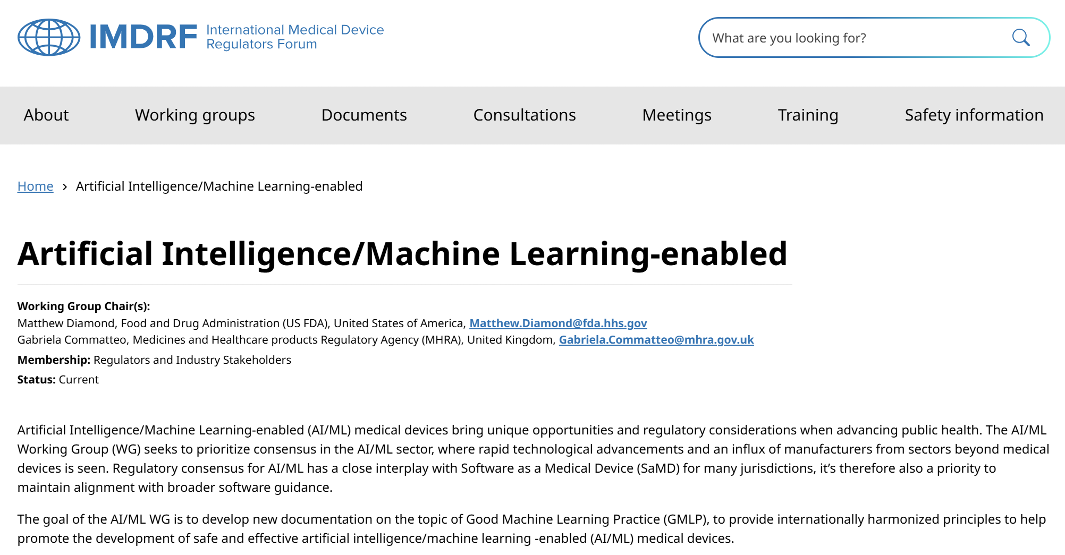
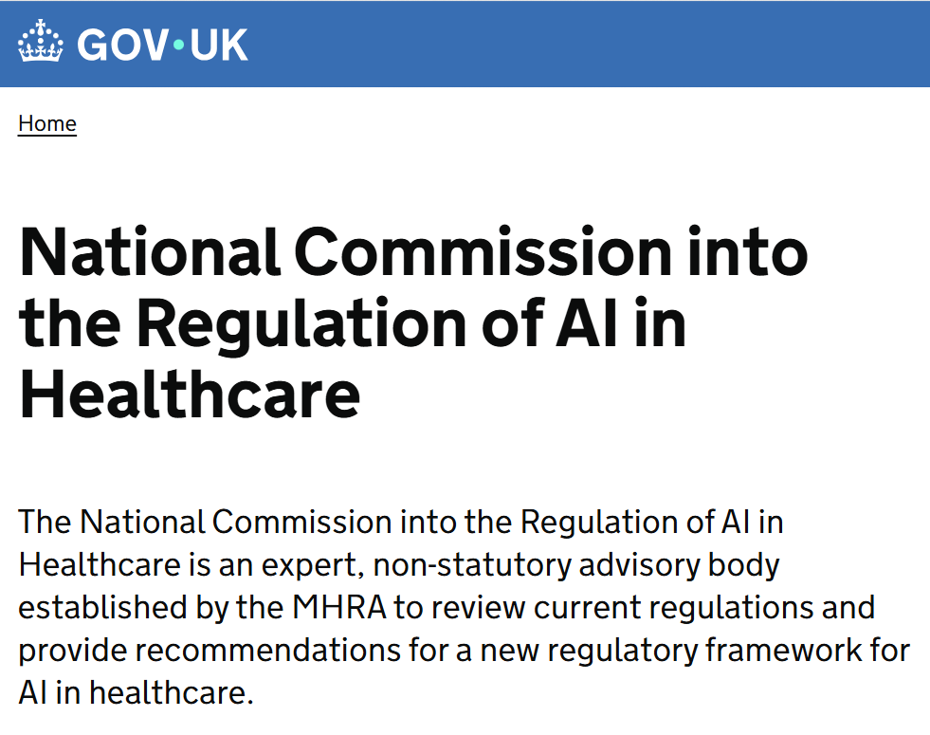

Thank you!
IMDRF AI/ML WG: imdrf-aiwg@fda.hhs.gov
National Commission: info@mhra.gov.uk
Gabriela Commatteo: Gabriela.Commatteo@mhra.gov.uk

