Slide 1



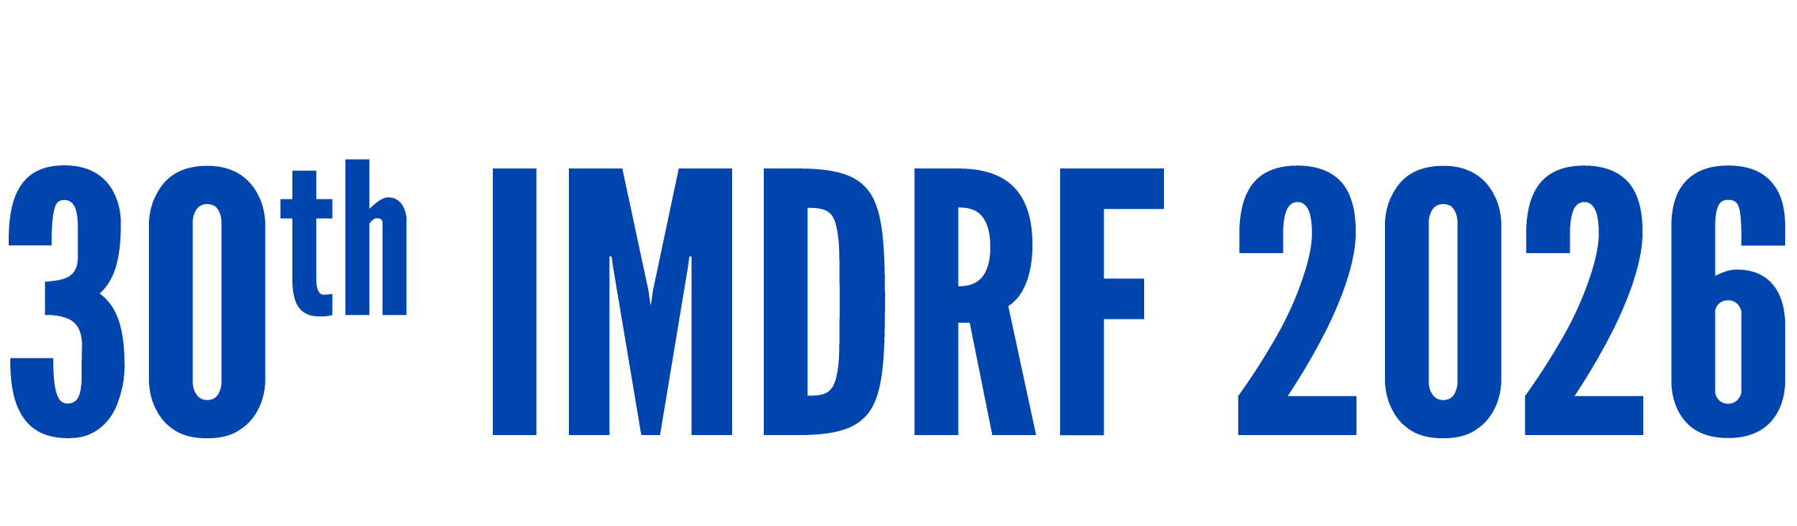
Day 1 IMDRF Industry Joint Workshop | 14 September 2026

Slide 2
AI Lifecycle Governance
Markus Wälti
Medical Devices Surveillance
Swissmedic, Swiss Agency for Therapeutic Products
Notes:
Good morning.
AI is often presented as a disruptive technology that requires entirely new regulatory approaches.
Today, I would like to share a different perspective.
Many of the challenges associated with AI can be understood through a broader shift toward lifecycle-based regulation.
And increasingly, regulators around the world are converging around common principles for addressing those challenges.

Slide 3
AI Is Accelerating the Shift Toward Lifecycle Regulation
Why regulation is changing
Medical technologies are becoming increasingly digital and interconnected
Innovation cycles are accelerating and software evolves more rapidly than traditional devices
Post-market evidence, monitoring and change management are becoming more important
AI is one example of a broader shift toward lifecycle-based regulation.
Notes:
Historically, regulation focused largely on products entering the market.
Today, digital technologies evolve much faster and require ongoing oversight.
As a result, regulators are placing greater emphasis on post-market monitoring, continuous evidence generation, and change management.
AI is one example of this broader shift toward lifecycle-based regulation.
If regulation is becoming lifecycle-based, what makes AI particularly challenging?

Slide 4
AI Raises Questions AcrosstheEntireProduct Lifecycle
AI challenges regulators not only at market entry, but throughout the product lifecycle.
Four Common Questions
Can we trust the data?
Can we trust the model?
Can we trust the clinical use?
Can we trust changes over time?
Regulators across jurisdictions are increasingly asking the same questions.
Notes:
AI highlights why lifecycle governance matters.
Regulators must assess not only the data and the model, but also how the device performs in clinical use and how changes are managed over time.
These questions arise across the entire product lifecycle, from development to post-market monitoring.
Importantly, regulators in different jurisdictions are increasingly asking the same questions.

Slide 5
Regulators Are Increasingly Asking the Same Questions
Shared regulatory questions are driving greater international convergence.
Across jurisdictions, regulators are increasingly focused on:
Data quality and evidence generation
Performance throughout the product lifecycle
Transparency, documentation and oversight
Convergence starts with shared questions, not identical regulations.
Notes:
Although regulatory frameworks differ, regulators are increasingly focused on the same underlying questions.
They want confidence in the data, confidence in device performance, and confidence that changes can be managed appropriately over time.
This common focus is creating greater alignment in regulatory thinking and provides the foundation for international convergence.

Slide 6
IMDRF Provides a Platform for Lifecycle Governance
IMDRF enables regulators to develop shared approaches to emerging lifecycle challenges.
IMDRF supports international convergence through:
Shared principles
Shared terminology
Shared guidance
Collaboration enables greater consistency across jurisdictions.
Notes:
As regulators face similar challenges, international collaboration becomes increasingly important.
IMDRF provides a platform for regulators to develop common principles, terminology and guidance.
This does not create identical regulations, but it helps build greater consistency in how emerging technologies are addressed across jurisdictions.

Slide 7
Common Lifecycle Principles Are Emerging Internationally
International convergence is increasingly visible across core lifecycle governance principles.
Examples include:
✅ Total Product Lifecycle (TPLC) Approach
✅ Good Machine Learning Practice (GMLP)
✅ IMDRF AI/ML Lifecycle Approach (N93)
✅ Post-Market Performance Monitoring
✅ Predetermined Change Control Plans (PCCPs)
The rules may differ, but the underlying principles are increasingly aligned.
Notes:
This convergence is already visible in practice.
Across jurisdictions, we increasingly see alignment around lifecycle principles such as GMLP, transparency, post-market monitoring, and change management.
The IMDRF AI/ML Lifecycle Approach builds on the broader Total Product Lifecycle framework and applies lifecycle principles to AI-specific challenges.
TPLC is the foundation; N93 applies it to AI/ML.
A recent example is PCCPs, which provide a framework for managing predefined changes within a lifecycle approach.
While regulatory frameworks remain different, there is growing alignment around the underlying principles.

Slide 8
Existing Lifecycle Principles Can Support AI Governance
AI introduces new challenges, but not new regulatory objectives.
AI may change the technology, but not the purpose of medical device regulation.
RegulatoryObjectives | AI Considerations
Safety | Data
Performance | Models
Benefit-Risk | Monitoring
Notes:
AI introduces new considerations, including reliance on data, the potential for model changes, and the need for ongoing performance monitoring.
However, the fundamental objectives of medical device regulation remain the same: ensuring safety, performance, and a positive benefit-risk balance.
From a lifecycle perspective, these challenges can increasingly be addressed within existing regulatory principles rather than through an entirely new regulatory paradigm.

Slide 9
Lifecycle Governance Supports Greater International Alignment
Alignment emerges from shared principles rather than identical regulations.
Lifecycle governance enables:
More consistent regulatory expectations
Greater predictability for manufacturers
Increased opportunities for international alignment
Shared principles create a foundation for greater alignment.
Notes:
As jurisdictions adopt similar lifecycle principles, opportunities for alignment increase.
This helps create more consistent expectations for manufacturers and supports a more predictable regulatory environment.
While regulatory frameworks will continue to differ, shared principles provide a common foundation for addressing emerging technologies such as AI.

Slide 10
The Future of AI Governance Is Increasingly Lifecycle-Based
Future AI governance is likely to focus on continuous oversight across the product lifecycle.
The future of AI governance will require:
Continuous evidence
Continuous monitoring
Continuous learning
Lifecycle governance provides a framework for managing increasingly dynamic technologies.
Notes:
Looking ahead, AI governance is likely to become increasingly lifecycle-based.
Across jurisdictions, we are seeing growing emphasis on continuous evidence generation, post-market performance monitoring, and structured approaches to managing change.
While implementation may differ, the overall direction is increasingly aligned.

Slide 11
AI may change the technology, but not the purpose of medical device regulation.
Notes:
AI may change the technology.
But it does not change the fundamental objectives of medical device regulation.
The challenge is not to reinvent regulation.
The challenge is to apply lifecycle principles effectively to increasingly dynamic technologies.
That is where international collaboration and IMDRF continue to play an important role.

