Slide 1



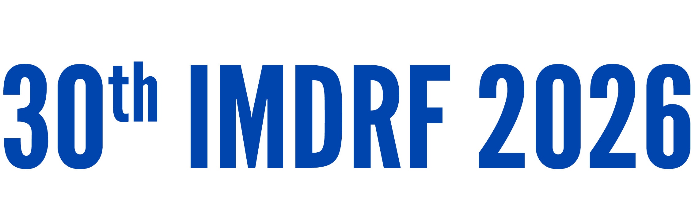
Day 1 IMDRF Industry Joint Workshop | 14 September 2026

Slide 2
Global Regulatory Landscape for Digital Health Technologies
Jasjit Baveja
Director, Regulatory and Industry Policy
Medical Technology Association of Australia (MTAA)

Slide 3
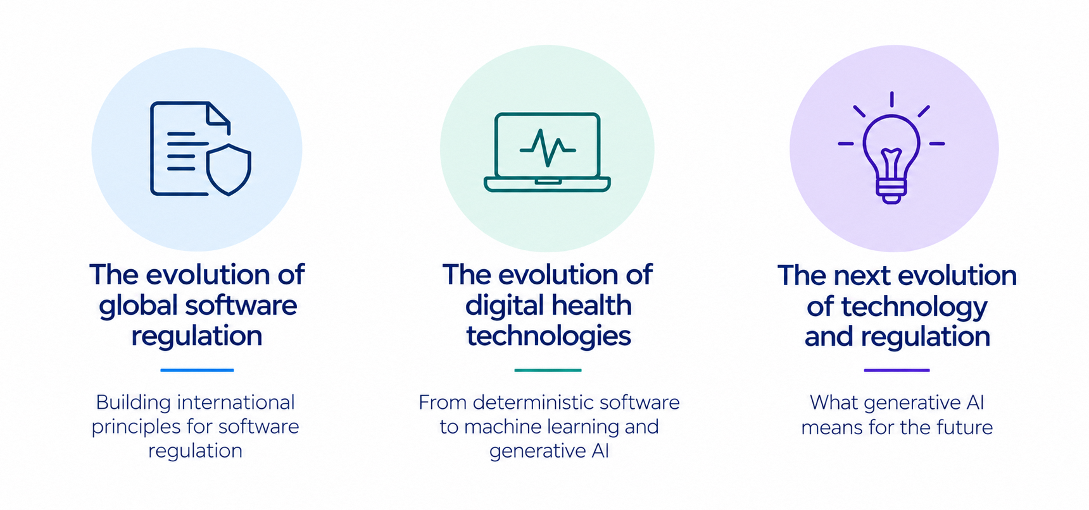

Slide 4
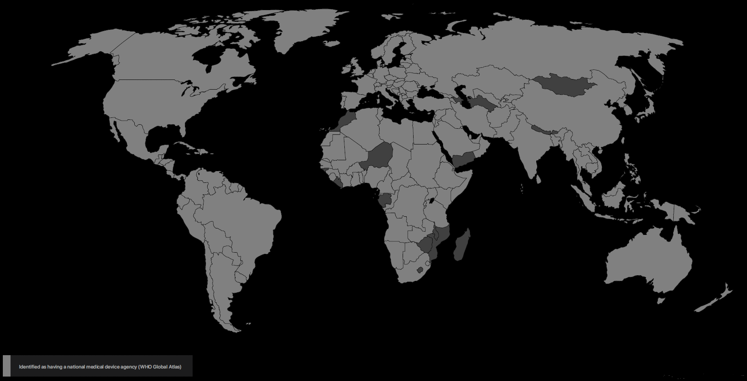
Jurisdictions with national medical device agencies

Slide 5
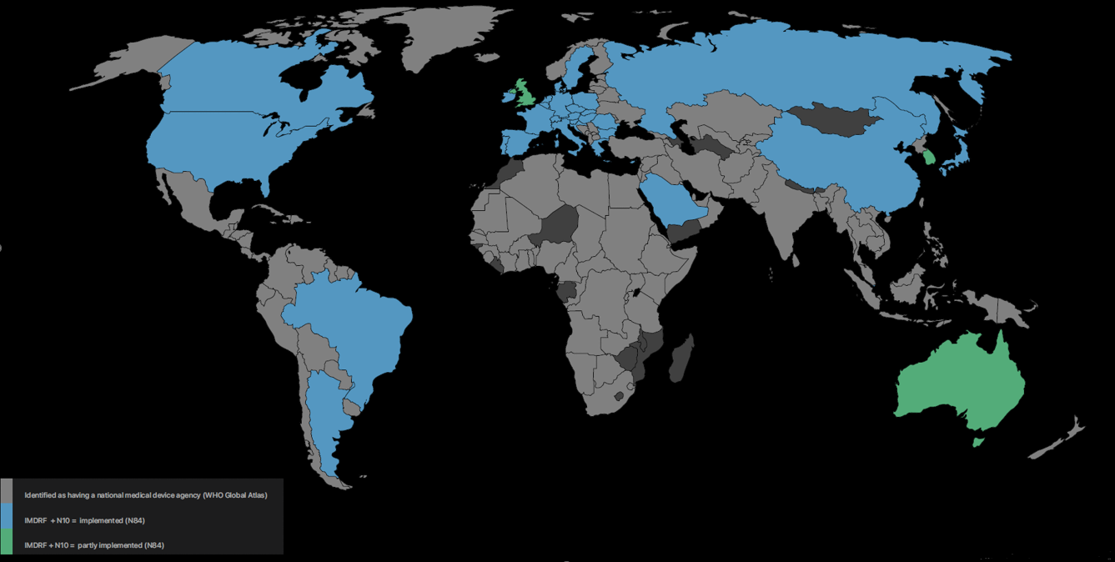
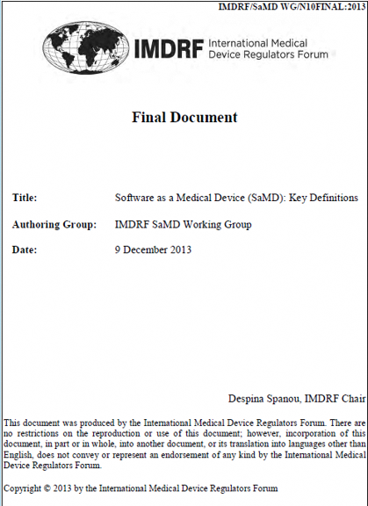
SaMD: Key Definitions (N10) Status – IMDRF Member Countries

Slide 6
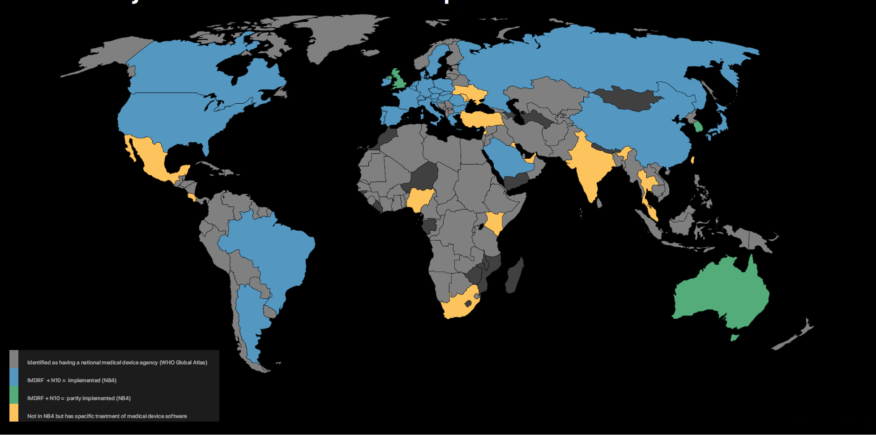
N10 + jurisdictions that have specific treatment of software

Slide 7
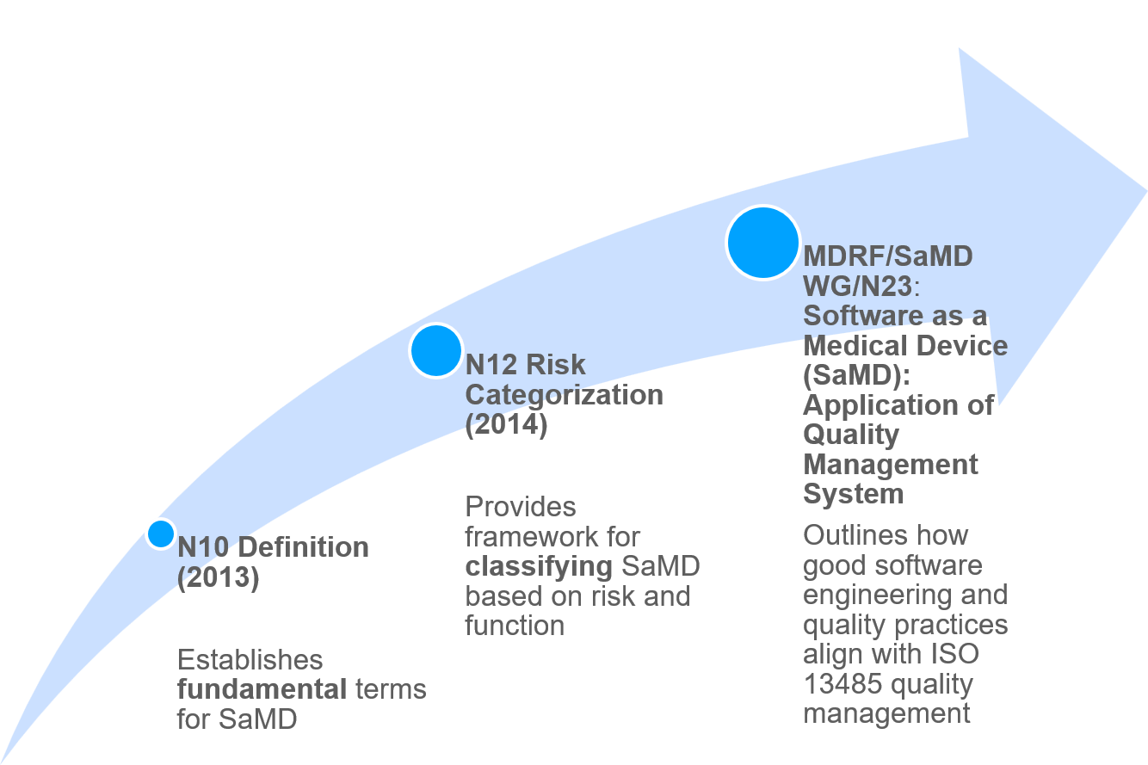
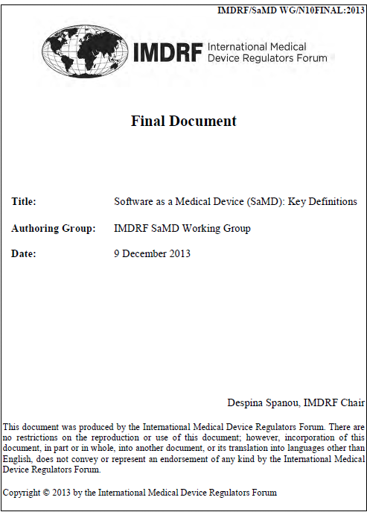
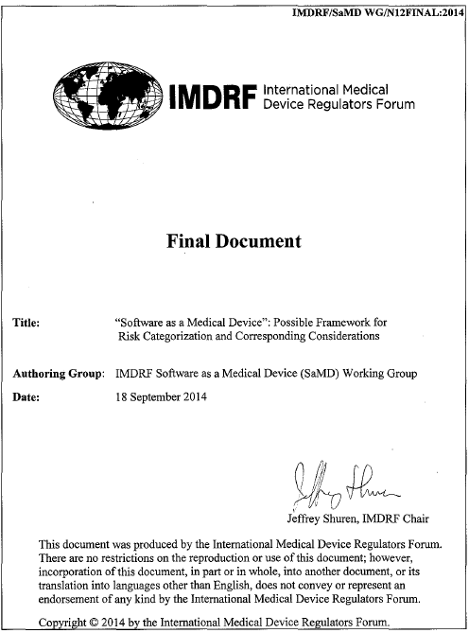
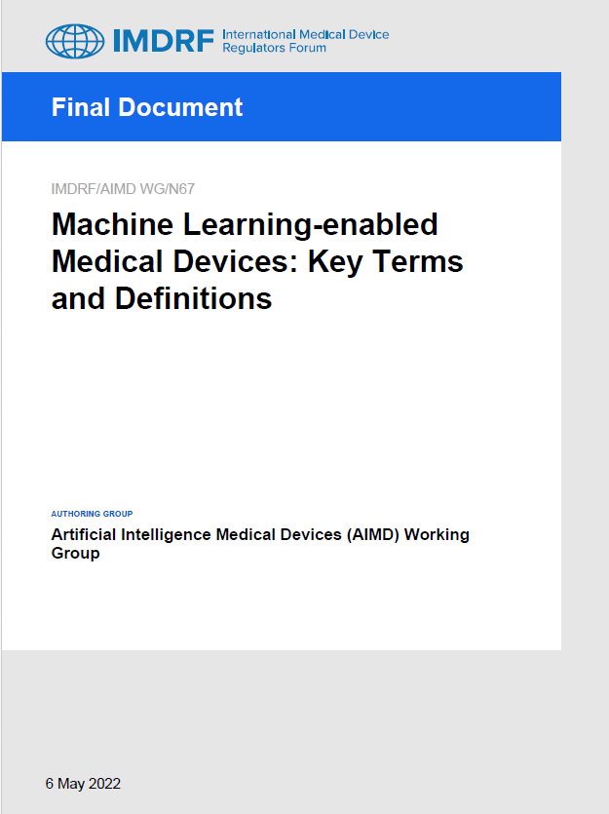

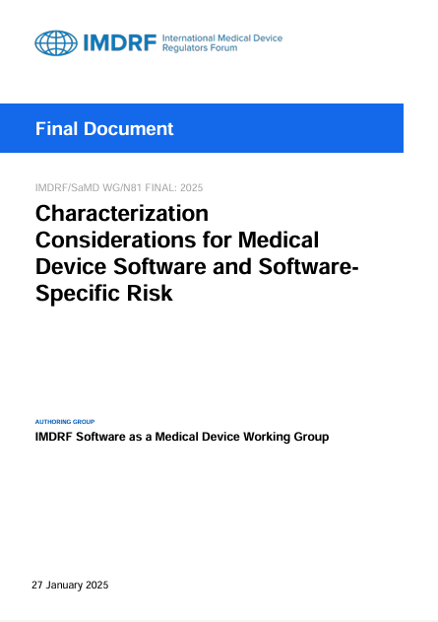
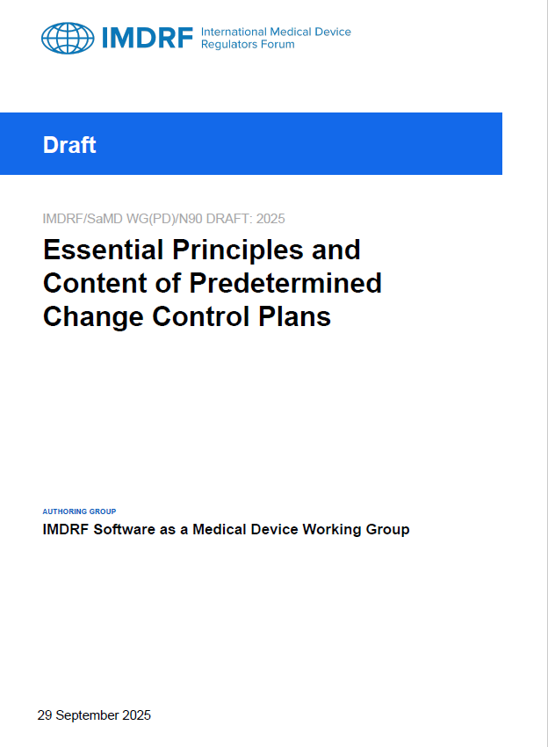
IMDRF Documents

Slide 8
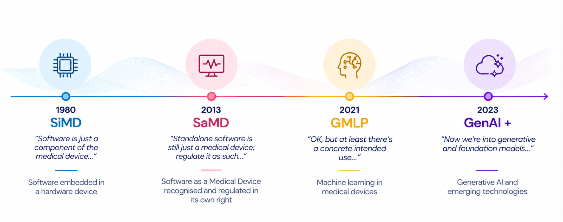
The evolution of software in Medical Devices

Slide 9
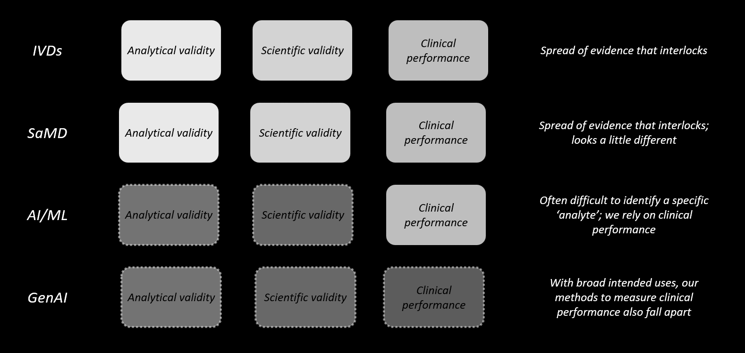
Regulatory iteration: diagnostic software

Slide 10
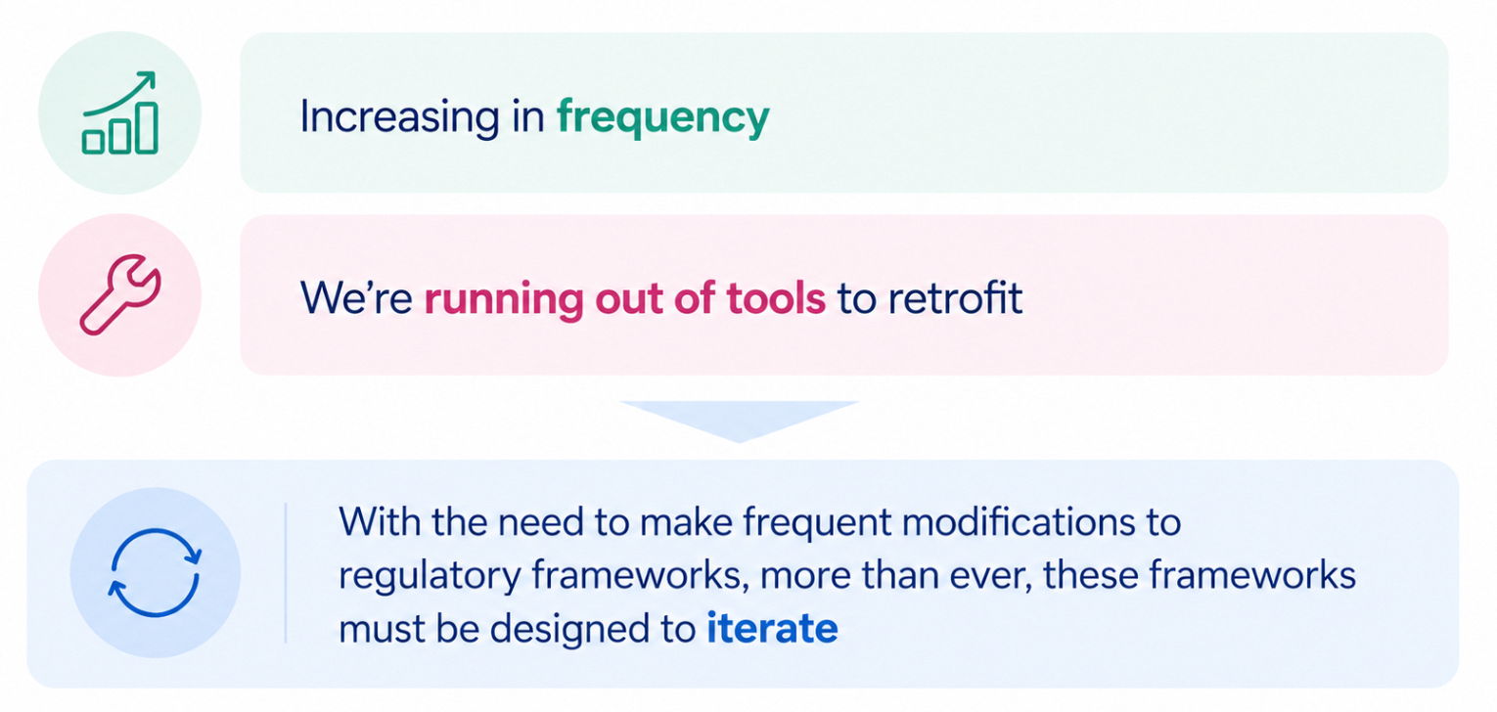
Innovation that requires regulatory innovation

Slide 11
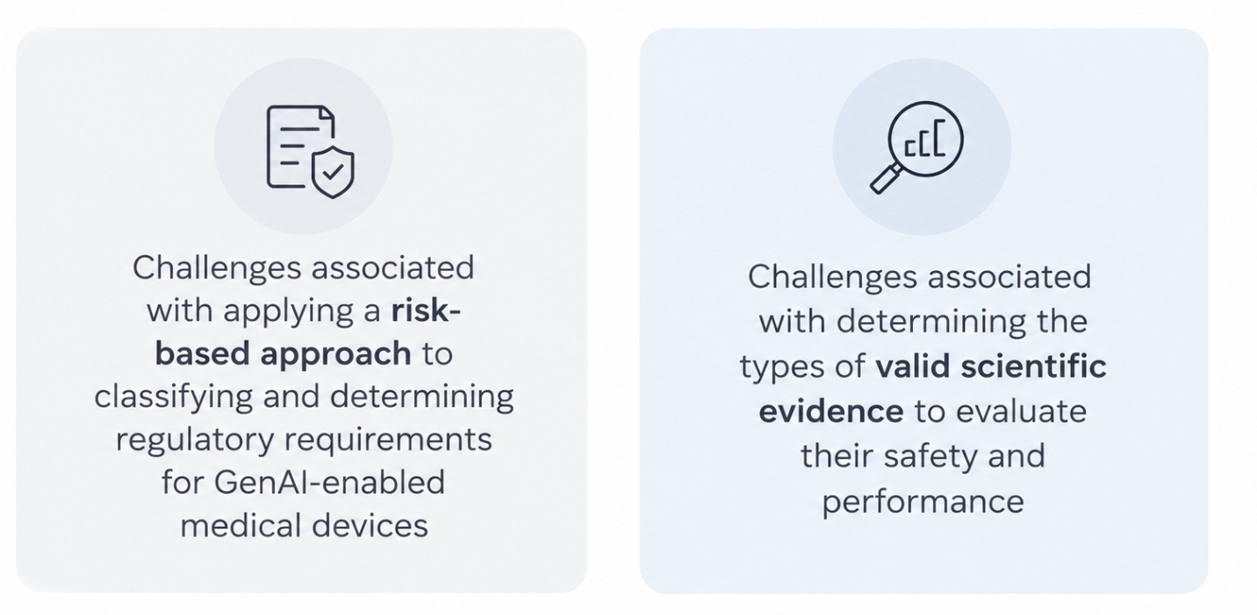
Two key regulations challenges that Gen AI brings

Slide 12
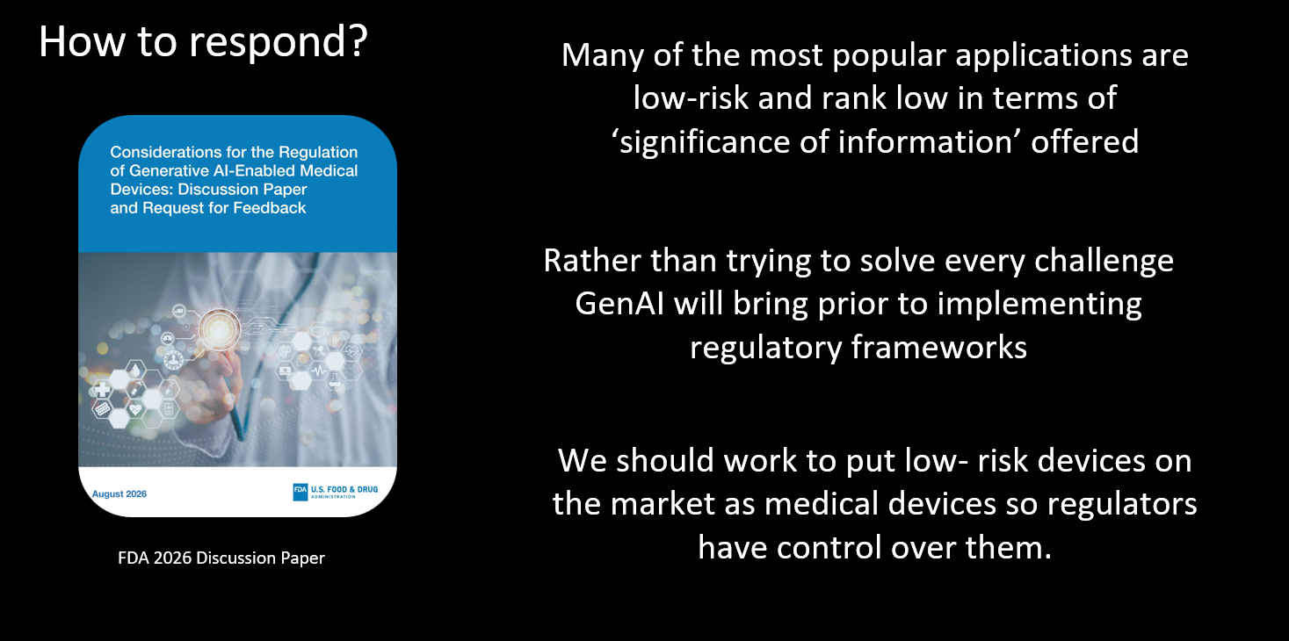

Slide 13

What’s Next?
What’s next?

Slide 14
Thank You!

