Slide 1



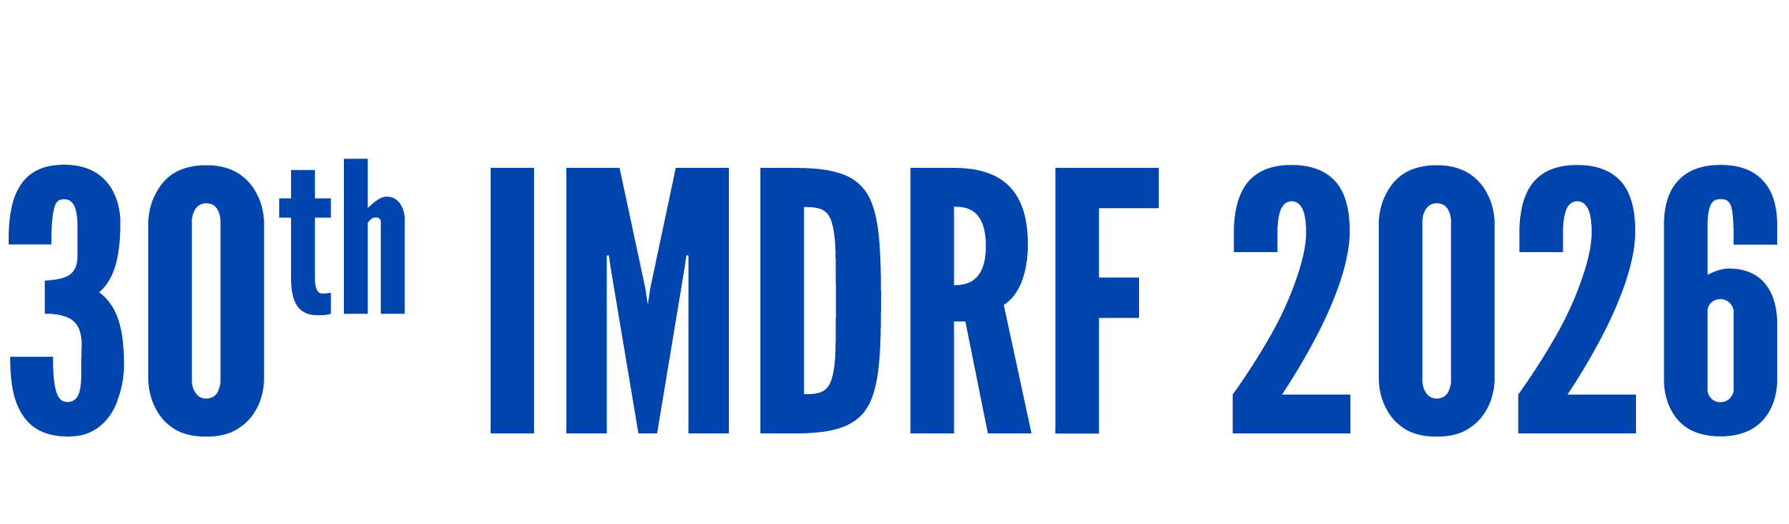
Day 1 IMDRF Industry Joint Workshop | 14 September 2026

Slide 2
PCCPs – An Industry Perspective
Diane Johnson
Senior Director of U.S. Regulatory and Global Digital Health Policy
Johnson & Johnson MedTech

Slide 3



Novel Regulatory Pathway
THE CURVE
Shared learning
Applicants and reviewers both build new expertise as the pathway matures.
THE SHIFT
Work moves upfront
V&V maintains patient safety; executed changes need no added review.
THE ACCELERATOR
Templates help
Tools could prove critical, as the U.S. FDA’s EUA templates did during COVID-19.
Prescriptive guidance is harder to implement but may strengthens HA trust.

Slide 4



Scope Boundaries, Not Blanket Exclusions
ACKNOWLEDGED Complex topics
Real-world evidence may be hard to include in a PCCP today.
THE RISK Overly broad limits
Excluding any change that may need clinical data blocks valid use cases.
THE TEST Specified and agreed
Allow changes whose V&V methods can be defined and agreed upfront.
Set boundaries by what can be specified and verified —
not by broad categories of change.

Slide 5




Managing Changes to the Protocol
THE REALITY Changes to the protocol are difficult to manage.
TODAY'S PRACTICE In current design development, protocol deviations are routinely addressed during verification and validation testing.
A DIFFERENT QUESTION This is separate from whether a submission is needed under change management requirements, e.g. design or manufacturing changes.
THE RISK If PCCPs are harmonized but each jurisdiction must be notified of any change, the utility decreases accordingly.

Slide 6






Select Jurisdiction Updates
US PRE-SUB
UNITED STATES Broadly scoped statute, with quite detailed guidance. 250 to datehttps://www.boleary.com/blog/posts/202408-pccp/latest/
EUROPEAN UNION PCCP planned; how Notified Bodies review them will matter. Potential to be highly flexible, e.g. via MDCG guidance.
UNITED KINGDOM MHRA is currently limited to software; expansion is recommended.
CHINA Greater alignment could streamline change management expectations and implementation.
JAPAN IDATEN already allows pre-approved change plans under PMDA approach.
Planning meetings between industry & regulators can facilitate execution, but the input needs to be durable.
A fundamental comfort with the approach is essential.

Slide 7


New Legal Authority Is Not Always Needed
THE PREMISE
Check the existing legal framework
Existing authority may already permit PCCPs — Canada implements them administratively.
THE BENEFIT
Lower burden
No need to identify a legislative vehicle — a real challenge in the EU and other jurisdictions.
Where existing authority allows, an administrative route is the faster, lower-burden path.

Slide 8



A Solution for Change Management?
THE CONTEXT
Varied approaches
Change management requirements and review triggers vary widely across jurisdictions.
THE OPPORTUNITY
Aligned PCCPs
Could be considered as an alternative approach for certain anticipated changes
THE CONDITION
Consistent regulatory expectations — Harmonized risk tolerance and review practices across jurisdications.
Alignment on PCCP approaches can improve predictability, reduce regulatory reviews, and speed patient access to improved devices.

Slide 9



A New Work Item Proposal
WHY NOW
Momentum exists
PCCP experience is growing but mostly limited to software and AI devices.
THE SCOPE
Broader scope
Extend beyond to all device types and regulatory pathways
THE ASK
Open an NWIP
Propose the NWIP through the appropriate working group.
A broader PCCP framework would deliver predictable change management across the full device landscape.

Slide 10
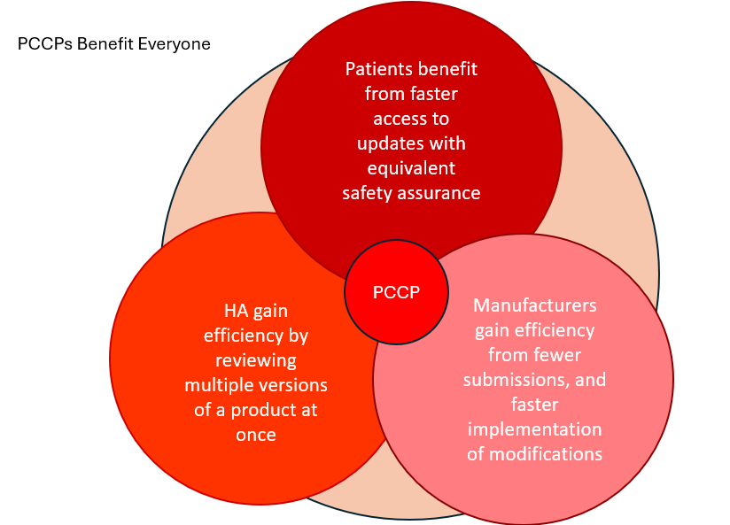
Thank
You!

