Slide 1



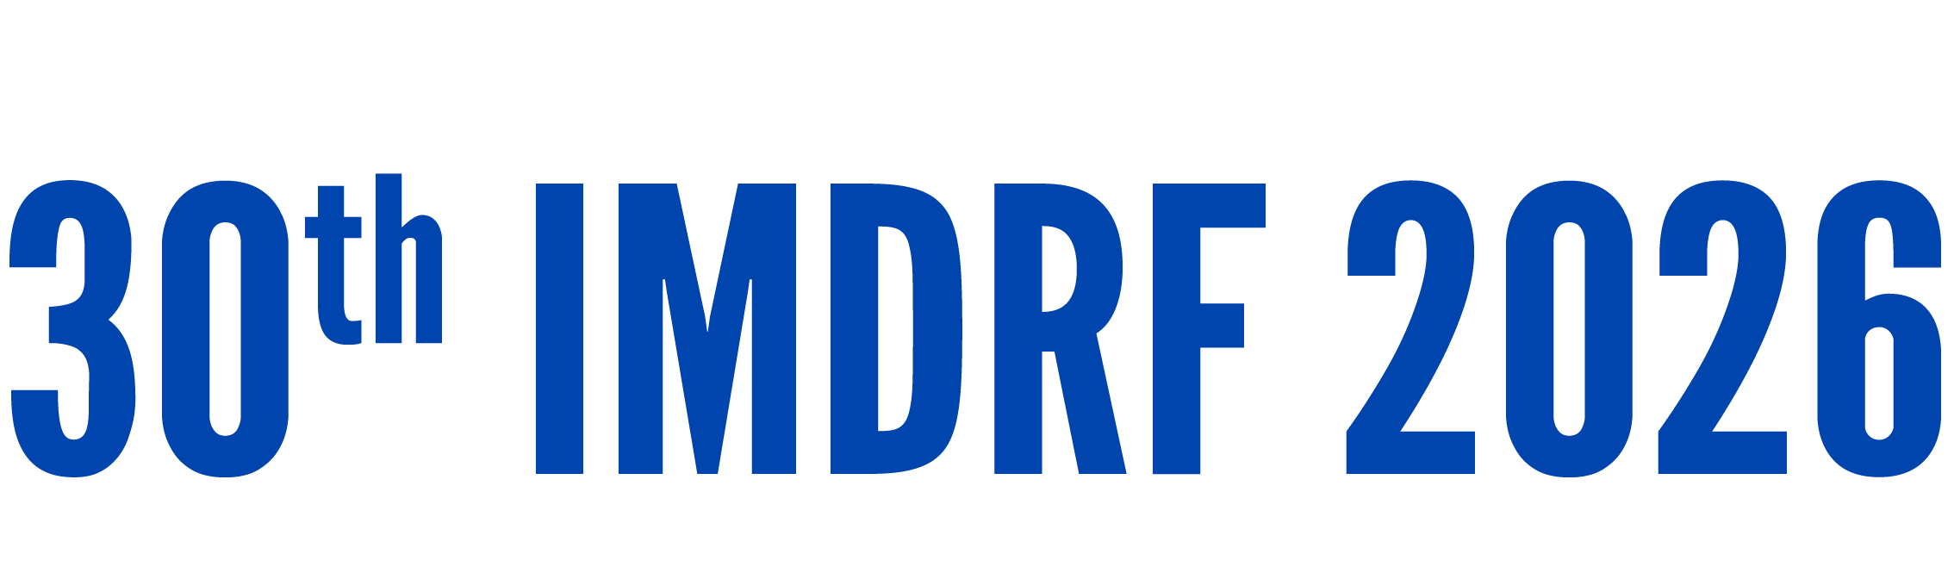
Day 1 IMDRF Industry Joint Workshop | 14 September 2026

Slide 2
Navigating Medical Device Cybersecurity:
Korea’s Regulatory Journey and Global Harmonization with IMDRF
Seungpyo Kim
Deputy Director
Digital Medical Products Support Management Division
Ministry of Food and Drug Safety(MFDS)

Slide 3
Regulatory History of Medical Device Cybersecurity in Korea
Key milestones from documentation requirements to statutory cybersecurity controls
FOUNDATION
2019–2020
ALIGNMENT
2022–2024
LEGAL FRAMEWORK
2025
2019
2022
2025
Approval & Review Notification amended
Guideline amended
Digital Medical Products Act enacted
Cybersecurity data submission made mandatory
IMDRF N60 requirements reflected
Cybersecurity regulation legislated
2019
2020
2024
2025
MFDS cybersecurity review guideline enacted
Digital Health Medical Device Review Task Force established
Guideline amended again
Security guideline notification enacted
Guidance for approval and review
Dedicated review capacity created
IEC 62443-4-2 requirements reflected
Guideline on security against electronic intrusions

Slide 4

International Alignment of Korea’s Medical Device Cybersecurity Regulations
With the enforcement of the Digital Medical Products Act (’25.1), a more security-strengthened Guideline on Security Against Electronic Intrusions (MFDS Notification No. 2025-30, ’25.4.29) was introduced
Establishes requirements for physical/and technical security and risk management for digital medical devices, response in the event of an electronic intrusion, vulnerability monitoring, and other matters necessary for security against electronic intrusions (5 areas, comprising 23 articles)

Slide 5
IMDRF Guidance Considered in the MFDS Security Guideline
Summary mapping between IMDRF guidance and the MFDS Guideline on Security Against Electronic Intrusions
IMDRF N60
Principles and Practices for Medical Device Cybersecurity
MFDS Guideline
MFDS Guideline covers requirements for digital medical devices including: secure communication • data protection • device integrity • user authentication • software maintenance • physical access • reliability and availability
Security Against
Electronic Intrusions
IMDRF N70
Principles and Practices for the Cybersecurity of Legacy Medical Devices
MFDS Guideline requires Manufacturer support and end-of-support / end-of-life planning • lifecycle vulnerability patching
Enacted considering IMDRF N60 and other international references
IMDRF N73
Principles and Practices for Software Bill of Materials for Medical Device Cybersecurity
MFDS Guideline recommends the use of SBOM for vulnerability discovery and incident response • MFDS Guideline requires data security measures during SBOM generation, storage, and transmission
Domestic regulatory requirements
Purpose of alignment: reflect globally recognized cybersecurity principles while adapting them to Korea’s domestic regulatory system.

Slide 6


Lifecycle-Based Cybersecurity Management
MFDS links pre-market cybersecurity review with post-market management from the review stage.
BEFORE APPROVAL
Review using cybersecurity guidelines
Cybersecurity review
Nov. 2019
MFDS Guideline on Approval and Review of Medical Device Cybersecurity enacted
Jan. 2022
Guideline amended with reference to IMDRF N60
Jul. 2023
Cybersecurity submission data requirements and documentation for modifications clarified
AFTER APPROVAL
Controls are considered before approval and maintained after market entry
Continuous cybersecurity management
QMS Conformity Audit
Review whether a system is in place in accordance with the Guidelines on Security Against Electronic Intrusions
Management system for cybersecurity incidents
Manufacturer’s vulnerability monitoring and response
SBOM Management recommended

Slide 7
Harmonization of Korea's Existing Security Regulations with Medical Device Regulation
A cross-agency incident reporting system is being established so that, depending on where a digital medical device-related security incident occurs, it can be classified and reported under either existing security regulations (Ministry of Health and Welfare, Personal Information Protection Commission, Ministry of Science and ICT, etc.) or medical device regulation (MFDS)
[Status of Incident Reporting Obligations by Target Category ]
Target | Reporting Entity | Competent Authority | Legal Regulations
Medical record breach incidents | Healthcare professionals, healthcare institution founders/operators | Ministry of Health and Welfare Ministry of Science and ICT | Medical Service Act Act on Promotion of Information and Communications Network Utilization and Information Protection
Personal data leaks, etc. | Personal information controllers | Personal Information Protection Commission Ministry of Science and ICT | Personal Information Protection Act Act on Promotion of Information and Communications Network Utilization and Information Protection
Electronic intrusions involving digital medical devices/operating environments | Digital medical device manufacturers, etc. | Ministry of Food and Drug Safety (MFDS) Ministry of Science and ICT | Digital Medical Products Act, Guideline on Security Against Electronic Intrusions Act on Promotion of Information and Communications Network Utilization and Information Protection
Public Institutios (National University Hospitals etc.) | Publice Institutions | National Intelligence Service Ministry of Science and ICT | National Cyber Safety Management Regulations, Information and Communication Network Act Act on Promotion of Information and Communications Network Utilization and Information Protection

Slide 8
Current Response Status at the South Korean Government
Joint inter-ministerial announcement of the “Roadmap for Strengthining SW supply Chain Security”(Jun.24, ’26)
→ Establishment 3 major strategies and 9 detail tasks
ㄴ
Long-term Tasks
Short-term tasks
Enhancing Capabilities for Supply Chain Threat Prevention, Detection, and Response
① Development fof supply chain security standards and guidelines, expansion of SBOM based management models
② Research on AI automation for supply chain security systems, establishment of secure development culture
③ Expansion of vulnerability discoverty channels such as bug bounties and vulnerability disclosure programs(CVD/VDP)
④ Building AI-based supply chain defense systems and linking public-private risk management systems
Creating Policy and Institutional Foundations
① Organization of a pan-government SW supply chain security consultative body
② Operation of a supply chain security forum to support private-sector autonomous activities
③ Supporting enterprises’overseas expansion through expanding mutual recognition of global certifications

Slide 9
Support to Improve Regulatory Compliance
Digital Medical Products Regulatory Support Center designated and operating since 2025
Support package: testing / inspection support, vulnerability analysis, VEX preparation and post-improvement testing
1
2
3
4
SBOM creation
Vulnerability analysis
VEX training
Verification testing
Support manufacturers in preparing SBOMs
Analyze vulnerabilities identified through SBOM and related tools
Train companies on preparation and use of VEX documents
Test results after remediation and improvements

Slide 10
Opportunities: Vulnerability Management and Response
Open-source management • SBOM use • national standard • shared vulnerability DB
1
Manage open-source risk
2
Use SBOM under current guidance
3
Build national response framework
Open-source vulnerabilities continue to emerge in software development
MFDS recommends using SBOM to discover vulnerabilities
Establish an SBOM national standard
Systematic management and response are needed
SBOM supports security, incident response and remediation activities
Share vulnerability database (DB)
Respond to vulnerabilities at the national level
Prepare approaches for mandatory SBOM application

