Slide 1




Day 1 IMDRF Industry Joint Workshop | 14 September 2026

Slide 2
The Future of MD Cybersecurity
Greg Dunkelberger
Manager, Regulatory Intelligence & Policy - EMEA
Resmed, Industry Representative

Slide 3
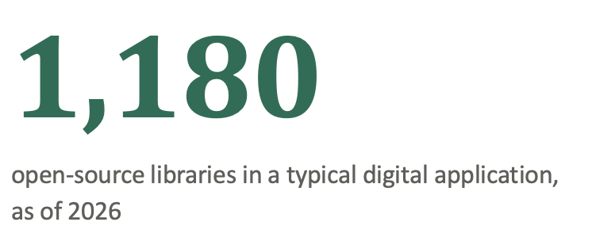
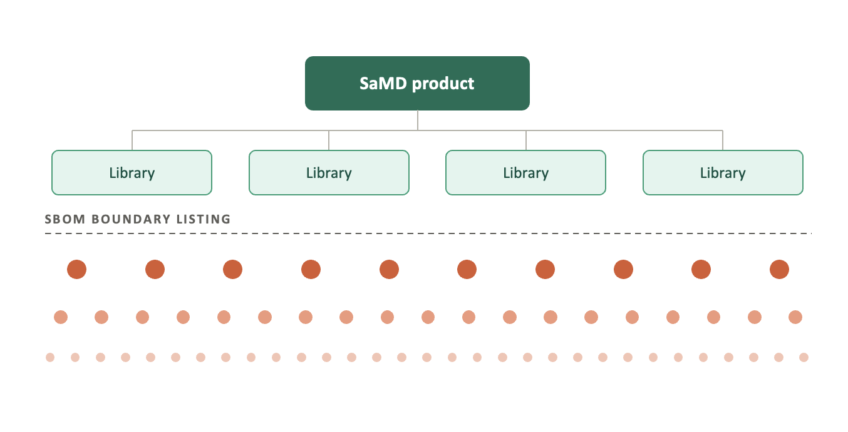
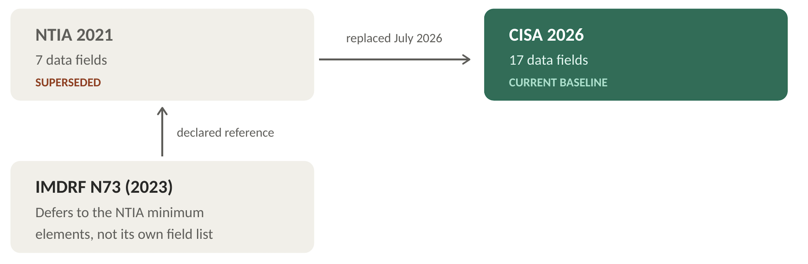
The Concern of Digital Supply Chains
Notes:
The N73 document and SBOM use is critical for all SaMD products
However, the SBOM concept needs thorough evaluation if we are to consider the truth depth of cybersecurity risks
98% of all codebases contain open-source elements that would necessitate an SBOM, with a typical digital application containing 1180 open-source libraries as of 2026*
Of these elements that would be found within an SBOM, multiple libraries are themselves composed of additional OSS elements
Digital vulnerability management becomes absolutely core to defending cybersecurity risks
N73 9.1(b) refers to the tracking of SBOM and recommends employing tools such as Software Composition Analyses (SCA) tools to continuously evaluate these third-party libraries.
This should be not only recommended but required for SaMD manufacturers. Not employing such tools or processes opens up digital significant supply chain risk
Recommend following the CISA 2026 that requires tracking of all lower transitive dependencies

Slide 4
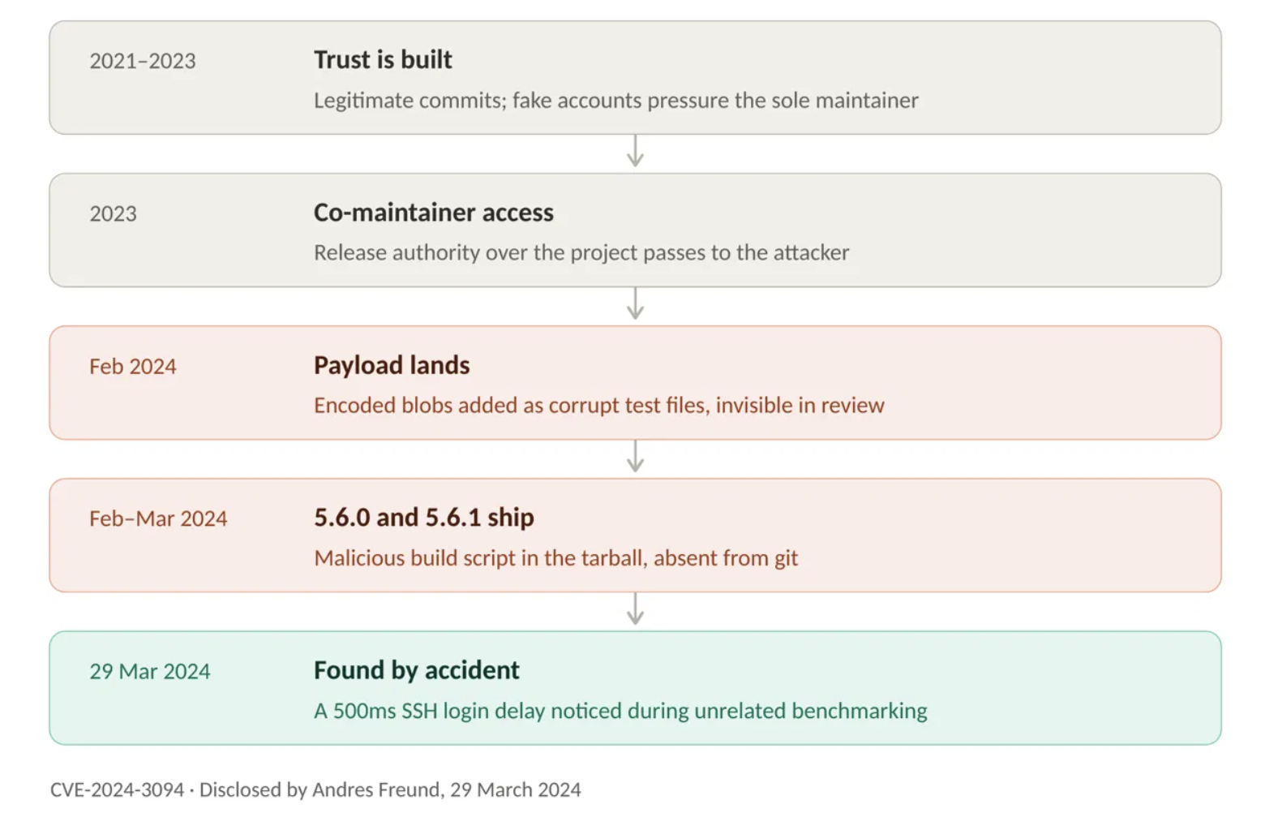
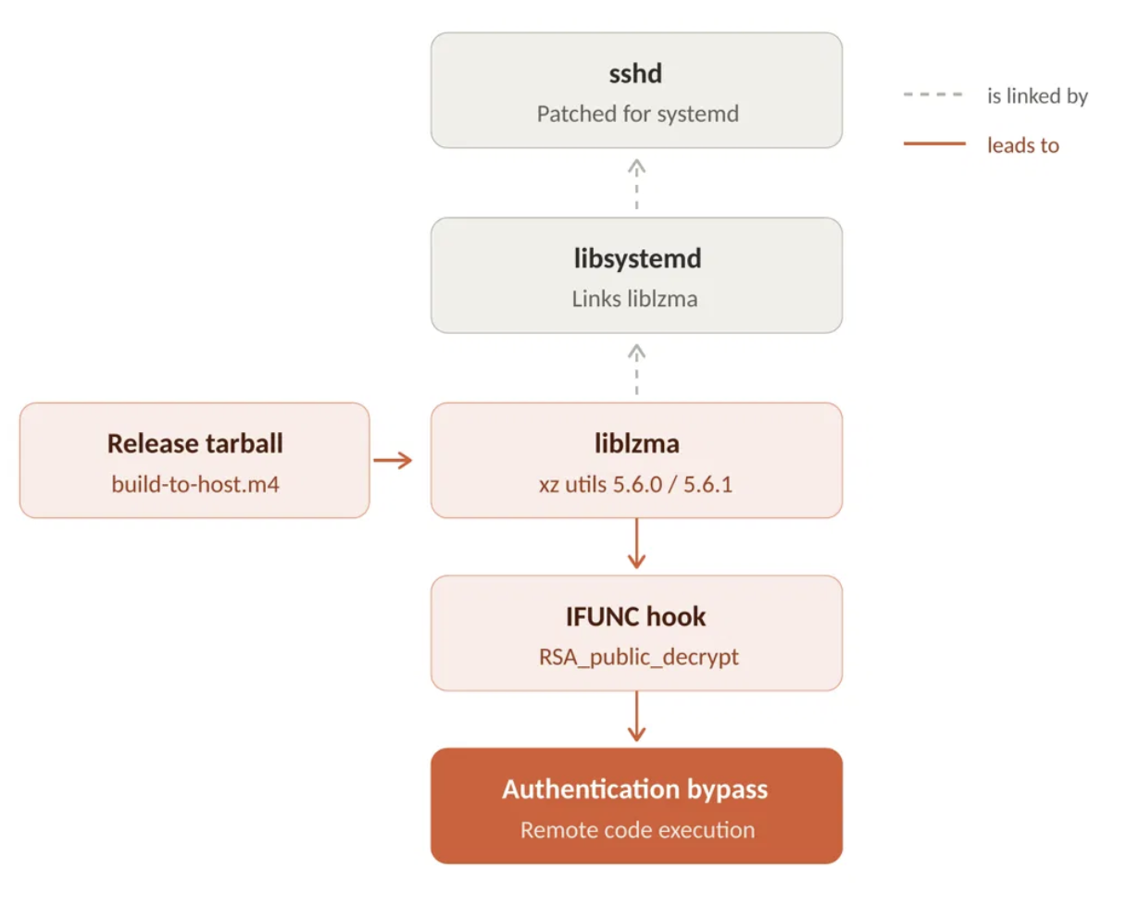
XZ Utils Case Study
Notes:
ENISA ID # CVE-2024-3094
A malicious user executes a multi-year social engineering attack to gain access to the xz project, a core compression library used by millions of software systems for remote access via SSH
After gaining access, bad actor subtly injects malicious code updates ultimately culminating in a script to provide a backdoor access to any device using SSH
Was only caught by a Microsoft researcher running a performance test of the release candidate build, noticed his SSH login took 600 ms longer than usual, leading to discovery of the malicious code
Exploited dependency was two layers deeper than the library that would be defined in a device’s SBOM

Slide 5
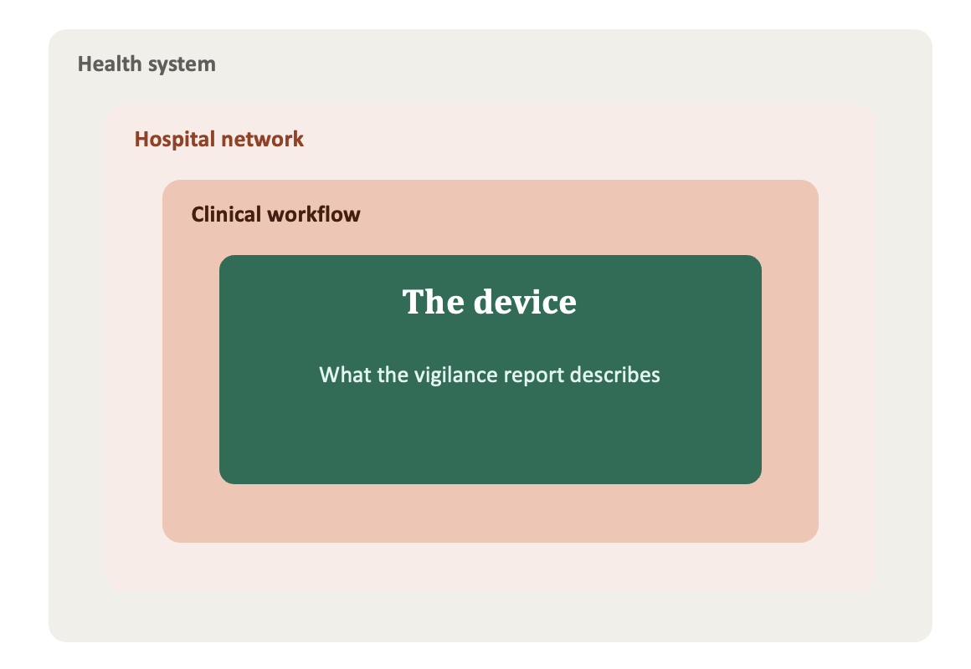
The Concern of Broader Cyber-Resilience Across Industry
ASSESSED TODAY
Product cybersecurity, reviewed against the device's technical file and general safety and performance requirements.
OUTSIDE THE QMS BOUNDARY
Organisational security posture such as ISO 27001, SOC 2 are needed, as they determine whether a manufacturer can detect, contain, and communicate an incident at all.
Notes:
While strict cybersecurity requirements of a device clearly fall under the remit of medical device regulators, what becomes obfuscated is the larger context in which these devices are placed.
Broadly speaking, cybersecurity does not exist in a vacuum. The broader context of how a device is placed within a clinical workflow must be considered when addressing cybersecurity issues.
While a manufacturer may report a vulnerability with their device, the obligation then falls to regulators to understand the broader impact scope of such an incident. There is greater onus for medical device regulators to now evaluate the full impact of such incidents.
Demands for greater cross-collaboration between cybersecurity agencies and medical device regulators
Manufacturer’s obligations for security controls such as ISO 27001, SOC2, now become increasingly important and interconnected. While the product cybersecurity elements are reviewed by a regulator, the organizational cybersecurity structures need assessment from regulatory agencies, as this extends beyond the existing, traditional QMS boundaries.
The CRA has exempted medical devices as they undergo cybersecurity review via conformity assessment under MDR/IVDR,

Slide 6
The Concern of Horizontal Requirements
One cybersecurity incident
MDR Art. 87
NIS2 Art. 23
GDPR Art. 33
Cyber Resilience Act
15 days
24 hours
72 hours
24 hours
National competent authority
CSIRT or competent authority
Data protection authority
ENISA and CSIRT
COM(2025)1023 would route cyber incident reporting to CSIRTs and ENISA through EUDAMED and add cybersecurity to Annex I of the MDR and IVDR. However, it does not harmonise the incident definitions or reconcile the clocks.
Notes:
With now dual reporting obligations of medical device manufacturers if a cyber incident results in patient safety, we are seeing multiple conflicts regarding incident reporting
Proposals to some regulations such as (COM(2025)1023) are discussing the use of EUDAMED regarding severe incident reporting.
Issue of definition of several reporting timelines and definitions of reportable incidents need harmonization and convergence
MD manufacturers may face increasing vigilance reporting decisions trees when now taking into account particular jurisdictions for trigger points for:
Reportable Safety Incidents
Reportable Privacy Incidents
Reportable Cybersecurity incidents

Slide 7
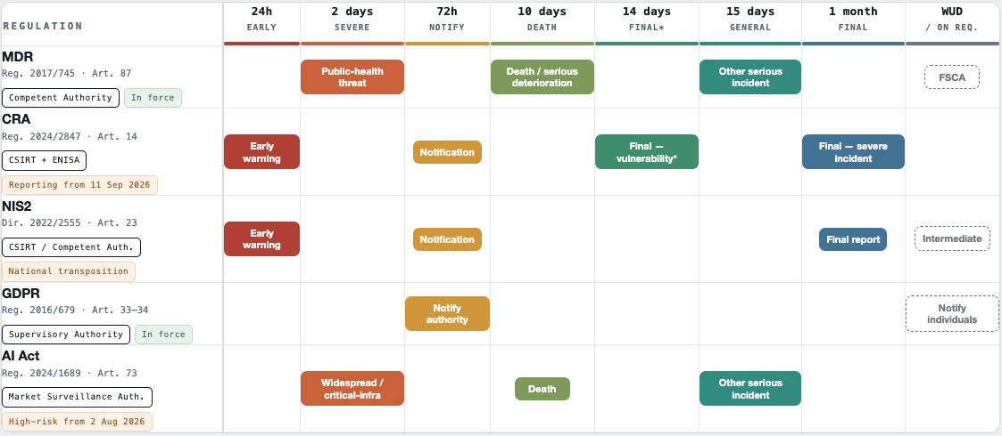
Potential reporting windows of digital products in EU
Notes:
EU as a case study for the misalignment of reporting timelines from incident discovery

Slide 8
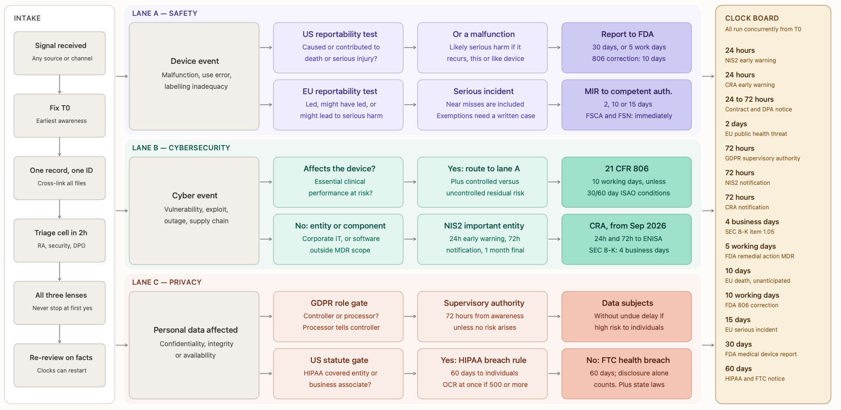
Potential Vigilance Decision Tree (Digital device, SaMD, US/EU)

