Slide 1



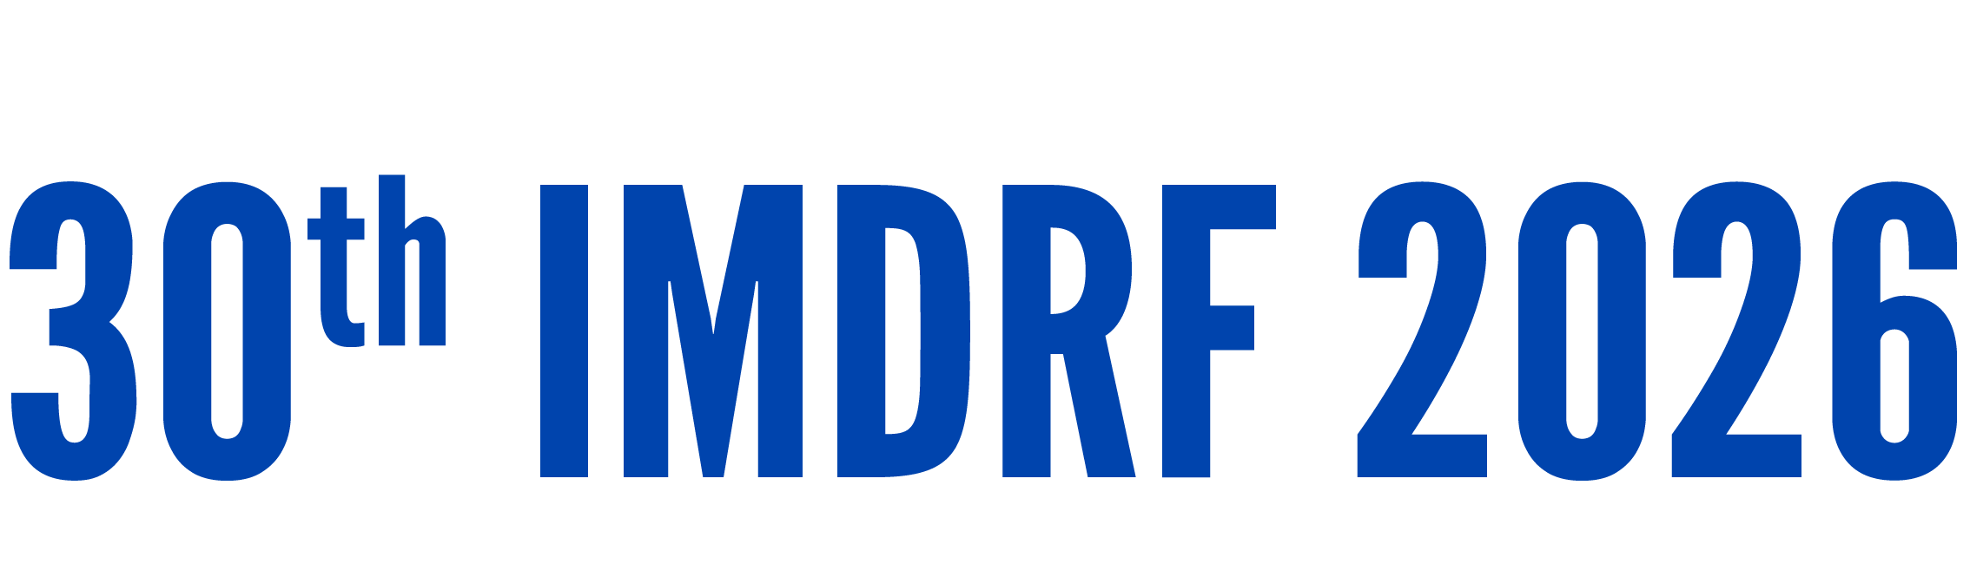
Day 1 IMDRF Industry Joint Workshop | 14 September 2026

Slide 2
Industry Perspective
Jad Wafeeq, PhD
Director, Quality Business Support – Software | Abbott Quality and Regulatory
Abbott

Slide 3
AI Is Not a Monolith: Governance Must Be Risk-Based
Model Type (ML vs. GenAI): Narrow predictive/classification models present defined, testable failure modes, whereas generative AI introduces non-deterministic and emergent behaviors requiring dynamic guardrails.
Model Behavior (Static vs. Adaptive): Locked algorithms rely on established pre-market V&V, while continuous learning models require ongoing monitoring (data, results and performance).
Level of Autonomy: Non-autonomous clinical decision-support software with active clinician review represent a lower risk profile than semi-autonomous or fully autonomous system.
Patient Safety Classification and Intended Use : Governance must align with patient risk severity, from low-risk workflow or patient-experience enhancements (Class I/Class A) to life-critical diagnostic and therapeutic interventions (Class III/Class C).
Effective governance must be aligned to intended use, level of autonomy, and potential impact on patients
A single governance model will not fit all AI applications. Regulatory oversight must be calibrated directly to the device AI model type, adaptability, autonomy, and patient safety impact
Notes:
What is in or about to be in the market.
Static vs adaptive
Mutli function systems.
AI in not on bucket when it comes to governing

Slide 4
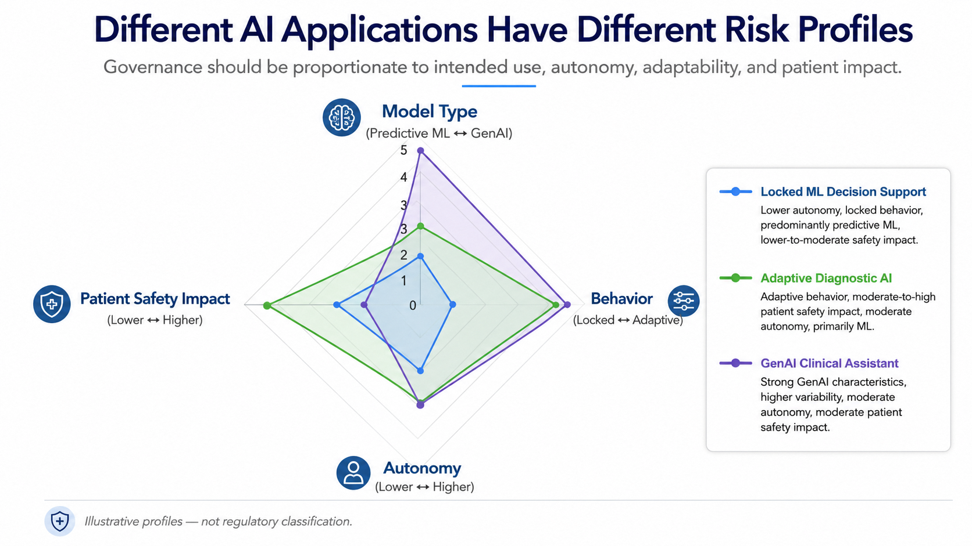
AI Generated Image

Slide 5
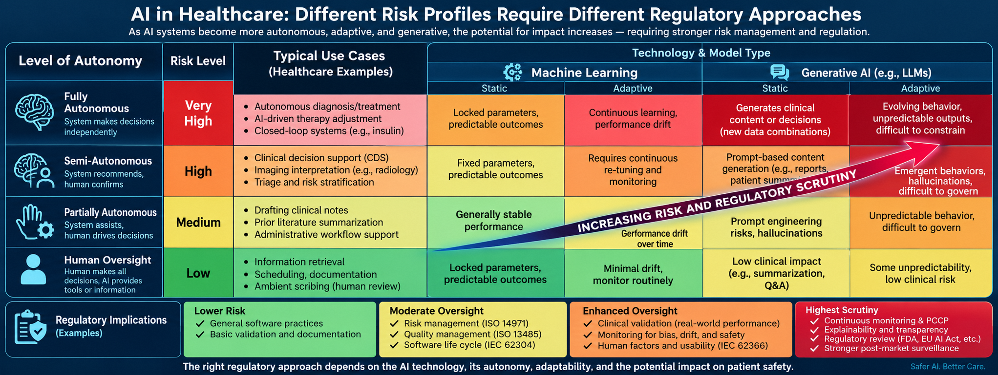
AI Generated Image

Slide 6
Industry’s perspective on what are the current challenges*
Global Regulatory Convergence:
  Multiple jurisdictions are developing AI frameworks simultaneously.
  Alignment of terminology, expectations, and evidence requirements remains a challenge for globally marketed products.
AI Lifecycle Governance is Still Maturing:
  Existing quality systems were largely designed around traditional software development (SDLC IEC 62304 vs TPLC).
  AI introduces new lifecycle considerations including data governance, model performance monitoring, drift management, and continuous learning.
Innovation vs Regulatory Predictability:
  AI technologies continue to evolve at an unprecedented pace.
  Industry seeks regulatory approaches that are sufficiently flexible to accommodate innovation while maintaining patient safety and public trust.
Roles, Responsibilities, and Accountability
  Increasing reliance on foundation models, LLMs, and third-party AI components creates new questions regarding accountability.
  Clear expectations are needed regarding responsibilities across AI providers, medical device manufacturers, healthcare organizations, and users.
*Not limited to
Notes:
From industry's perspective, the greatest challenge is not the existence of AI regulation, but achieving globally harmonized, predictable, and scalable regulatory frameworks that can keep pace with rapidly evolving AI technologies while continuing to protect patients and users.
Data Availability and Representativeness
Access to diverse, representative, and high-quality datasets remains a significant challenge.
Privacy, data-sharing restrictions, and regional differences can impact model development and validation.

Slide 7
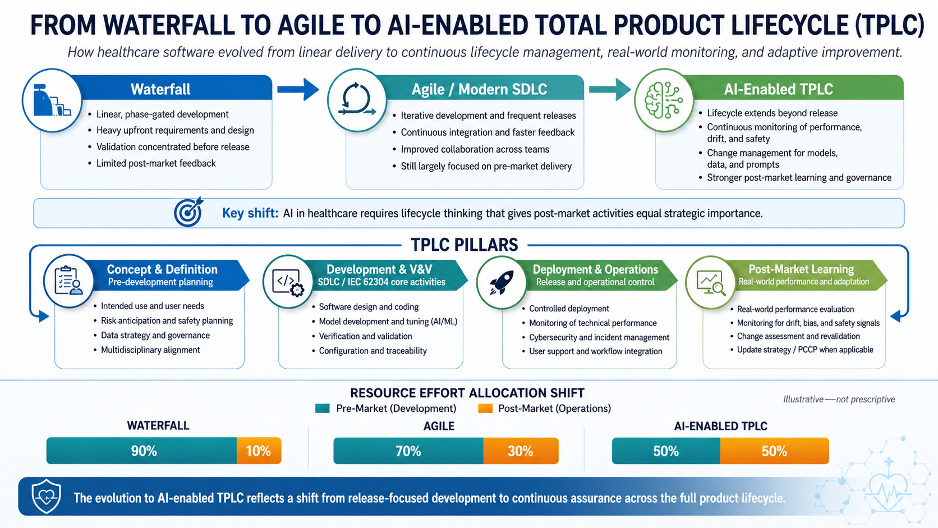
The Paradigm Shift: From Static SDLC to AI-Driven TPLC
Software Methodology is shifting:
Traditional software was largely static and release-driven.
Agile accelerated development, end user engagement/feedback but remained focused on pre-market activities.
AI-enabled products continue to learn, evolve, and generate new risks after deployment.
Effective governance now requires Total Product Lifecycle (TPLC) management.
Challenges in Adopting TPLC:
Defining responsibilities across the full AI lifecycle.
Monitoring drift, performance, and safety in real-world use.
Managing updates, retraining, and foundation model changes.
Aligning lifecycle expectations across global regulators.
Transitioning organizations from release-focused thinking to continuous lifecycle management.
SDLC: Software Development Lifecycle | TPLC: Total Product Lifecycle.
AI Generated Image

Slide 8

Poll – What is the biggest challenge in regulating AI-enabled medical device?
Panel Discussion 2
Global Regulatory Harmonization (aligning requirements and expectations across jurisdictions)
Post Market Monitoring (real-world performance, data drift )
Risk-Based Regulation (Applying the appropriate level of regulatory oversight based on risk)
Adaptive AI and Change Management (Managing updates, retraining, and evolving AI models)
SCAN QR CODE
Go to
pigeonhole.at
OR
Enter passcode
546SFQ63

